Slide 1
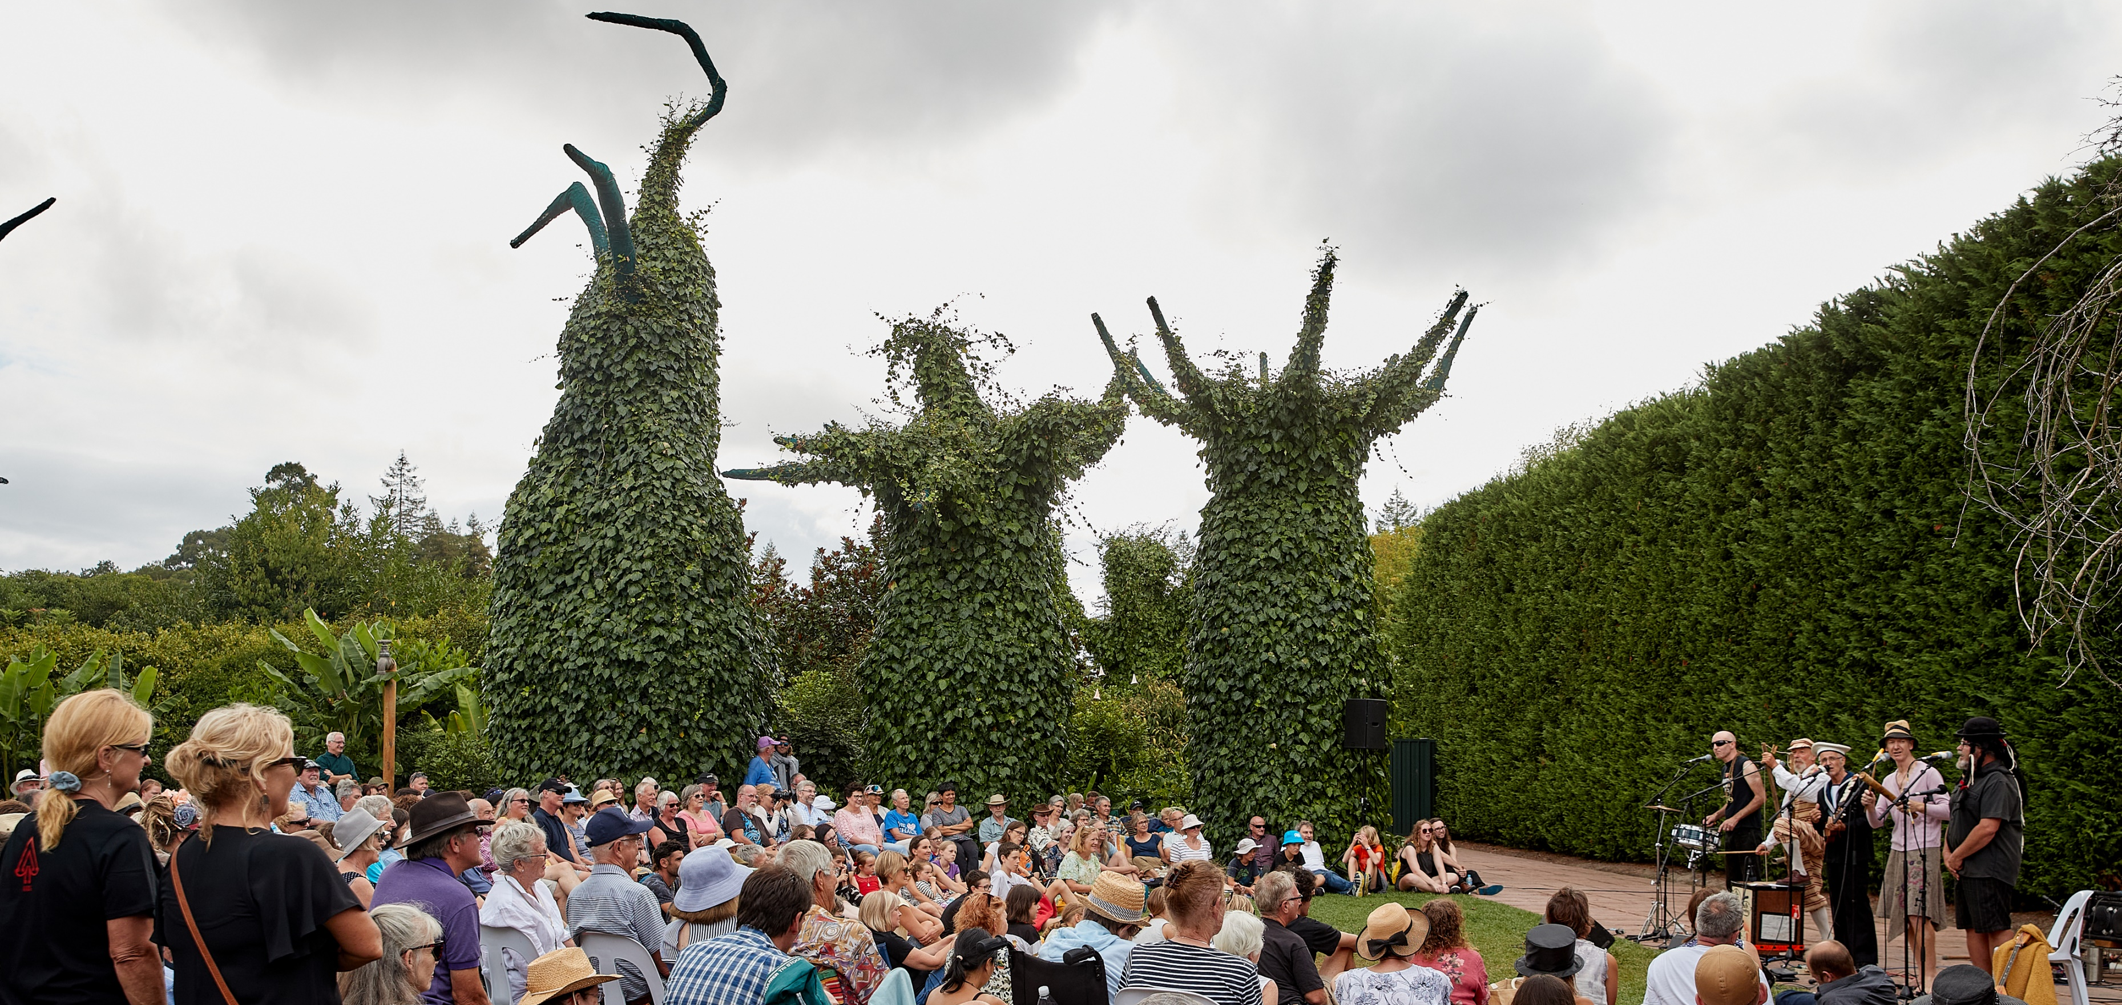
New Zealanders AND THE ARTS
Ko Aotearoa me ōna toi
2020
Photo: Hamilton Arts Festival 2020, Photography by Mark Hamilton Photography

Slide 2
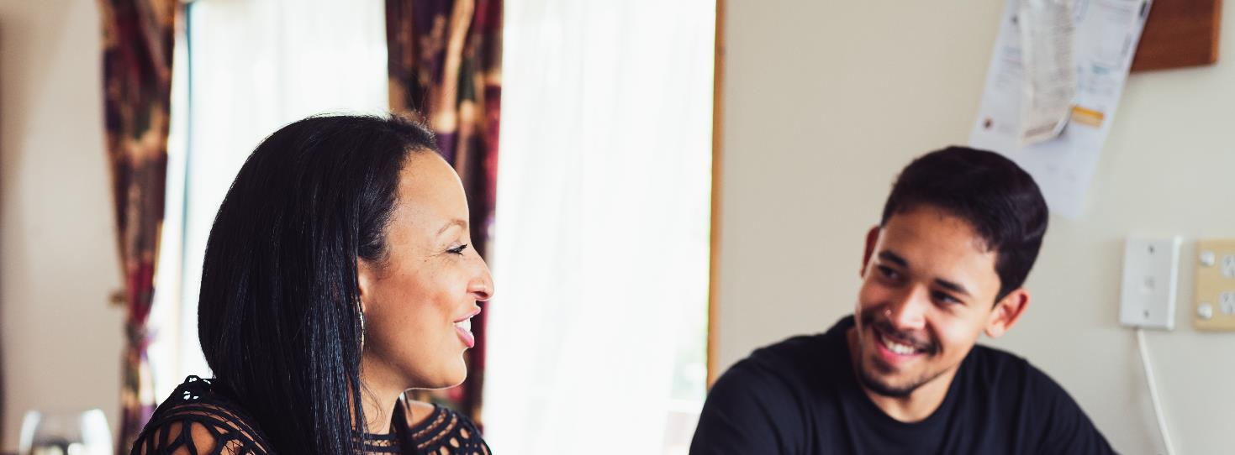
SURVEY METHOD
Adult survey
Young persons survey
6,263 online interviews with adults aged 15 plus
Core national sample of 4,500 New Zealanders which was boosted by ethnicity and region
Interviews took place between 2 October and 2 November
754 online interviews with young people aged 10 to 14
Minimum interviewing targets set for ethnic groups
Interviews took place between 9 October and 29 October

Slide 3
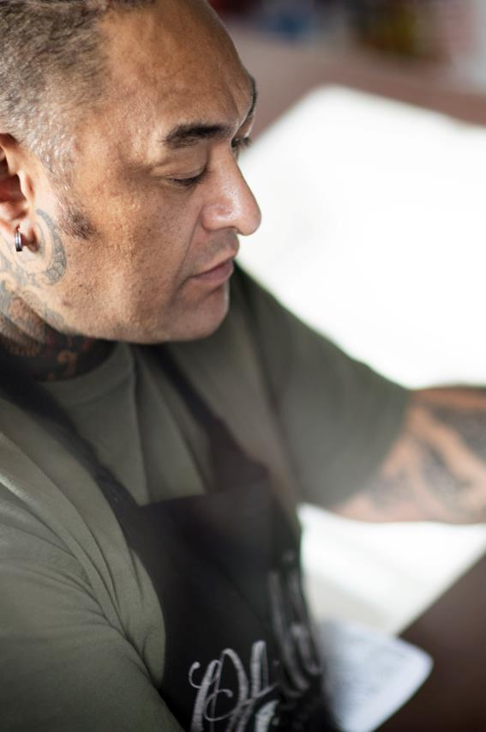
Adult Survey HEADLINES
1
Attendance has declined this year at an overall level, but this is driven solely by a drop in attendance for the performing arts
Participation has held steady despite COVID-19
Just over half of New Zealanders would like to have the choice of attending the arts online in future
New Zealanders are more positive than ever before in their attitudes towards the arts
The arts play a role in supporting New Zealanders' wellbeing
New Zealanders have embraced Ngā Toi Māori like never before
2
3
4
5
6

Slide 4
Engagement, attendance and participation
Attendance has declined since 2017, while participation has held steady
%
= significantly higher / lower than 2017

Slide 5
Attendance by art form
The decline in attendance is driven solely by a drop in performing arts attendance
%
= significantly higher / lower than 2017

Slide 6
Engagement for key audiences
Māori and Pacific peoples are more engaged with the arts than average (75%)
80%
80%
76%
76%
More likely to participate in the arts than average
(61% vs. 52%)
= significantly higher / lower than the national average

Slide 7
Barriers to engagement for key audiences
Some barriers to engagement are more relevant for certain demographic groups
People with the lived experience of disability
Māori
Pacific peoples
Asian New Zealanders
If there were more arts events that appealed to me
If tickets were cheaper
If I could go with someone
If arts events were of high quality
If I were confident of feeling welcome
If I knew there would be more people like me going
= significantly higher than the national average

Slide 8
Accessing the arts online
How we want to access the arts is evolving. There is evidence that greater access to the arts online will help to democratise the arts.
Subgroups more likely to have attended various art forms online:
Young people aged 15 to 17
Māori
Pacific peoples
People with the lived experience of disability
Low income households
52%
would like to have the choice of attending the arts in person or watching online

Slide 9
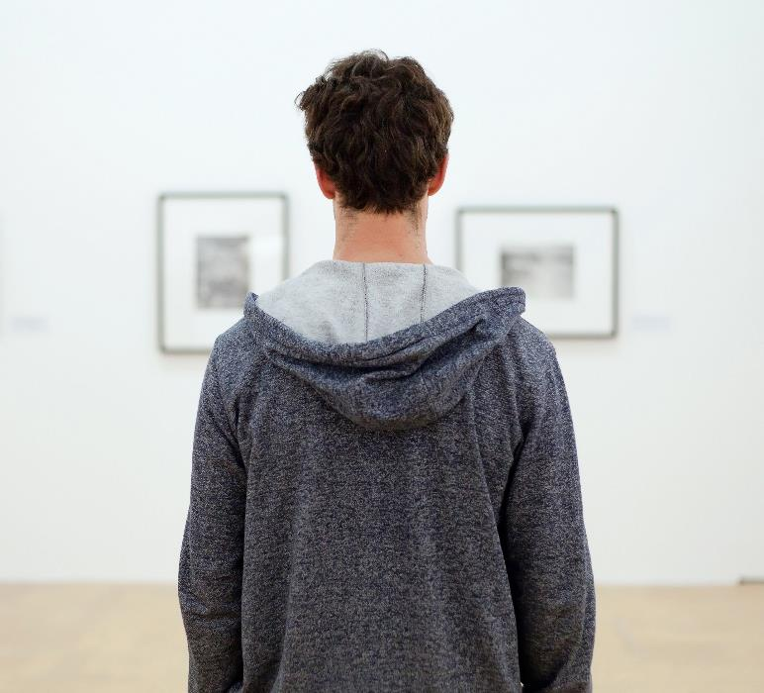
Attitudes towards the arts
New Zealanders are more positive than ever before in their attitudes towards the arts
%
More negative
More positive
Has your view of the arts changed in the last 12 months?
Unchanged / don’t know

Slide 10
Attitudes towards the arts
It appears that COVID-19 has played a key role in greater levels of appreciation towards the arts
Especially in these times, when people couldn't leave home for weeks at a time, consuming the arts is what kept a lot of people sane.
Through COVID-19 I've learned that having access to the arts, in particular, public interactive art is important for all of us. During lockdown, public art was very important to me during my exercise and walks for fresh air. I've also learned that due to COVID-19 our access to the arts, such as performance and creative arts has enabled me to appreciate more than I perhaps did, how important the arts are in our lives.
After coming out of lockdown where we couldn’t do anything I appreciate even more going to the theatre, the gallery, Māori performances, and art classes.
I have better access to the arts now than previously. Since lockdown I have wanted to be more creative and use my time differently.

Slide 11
The arts and wellbeing
The arts play a role in supporting New Zealanders wellbeing, even more so during COVID-19
Q
How important is the arts to your personal wellbeing?
Q
Would you say the arts have become more or less important to your wellbeing since COVID-19 arrived in New Zealand?
%

Slide 12
Attitudes towards the arts
New Zealanders are increasingly recognising the economic and societal benefits of the arts
%
= significantly higher / lower than 2017

Slide 13
Greater support for public funding of the arts
This flows through into increased support for public funding of the arts
%
The arts should receive public funding
My local council should give money to support the arts
= significantly higher / lower than 2017

Slide 14
Attitudes to Ngā Toi Māori
More New Zealanders agree that Ngā Toi Māori motivates them to kōrero te reo and improves their wellbeing than in 2017. These positive shifts are driven by those who don’t identify as Māori.
Helps Māori connect with their culture
Helps define who we are as NZers
Helps us learn about Māori culture
Not asked of all New Zealanders
69%
57%
72%
45%
57%
Māori
All New Zealanders
Māori
All New Zealanders
Māori
60% in 2017
81% in 2017
Motivate people to learn Te Reo
Motivates people to kōrero Te Reo
Improve our wellbeing
32%
55%
29%
53%
28%
49%
All New Zealanders
Māori
All New Zealanders
Māori
All New Zealanders
Māori
24% in 2017
25% in 2017
55% in 2017

Slide 15
Attitudes to Pacific arts
Pacific arts benefit all New Zealanders in a number of ways
Helps Pacific peoples connect with their culture
Help us learn about Pacific cultures
Helps define who we are as NZers
Not asked of all New Zealanders
72%
47%
64%
44%
65%
Pacific peoples
All New Zealanders
Pacific peoples
All New Zealanders
Pacific peoples
Improve our wellbeing
Motivates people to learn a pacific language
24%
56%
15%
54%
All New Zealanders
Pacific peoples
All New Zealanders
Pacific peoples

Slide 16
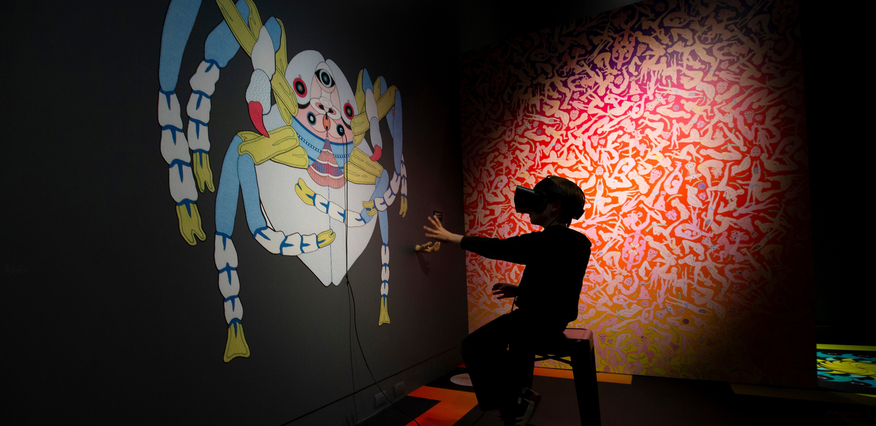
Young persons
Te aro taiohi
2020
Photo: Dowse Art Museum, Terminus by Jess Johnson and Simon Ward. © Hagen Hopkins Photography 2020

Slide 17
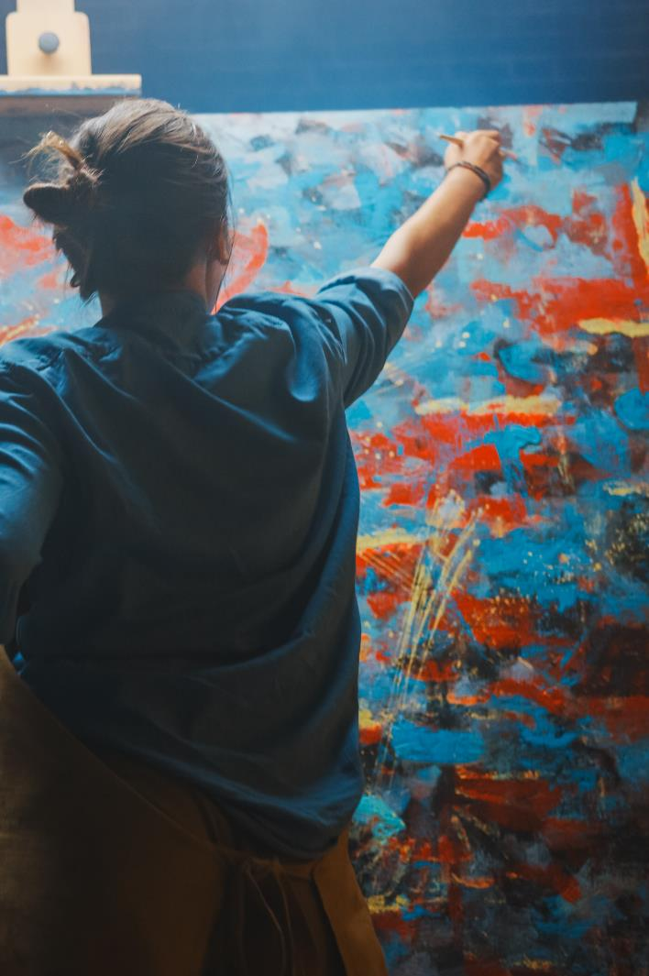
Young persons HEADLINES
1
Overall engagement is stable, but attendance has declined
Young New Zealanders are feeling more creative than ever
Young people are increasingly seeing the benefits of the arts to their wellbeing
Parents help shape the attitudes of their children towards the arts
2
3
4

Slide 18
Attendance
Attendance has declined since 2017
%
= significantly higher / lower than 2017

Slide 19
Attendance by art form
This decline is driven by all art forms, with the exception of Ngā Toi Māori
%
= significantly higher / lower than 2017

Slide 20
Participation
While attendance has declined, participation has held steady. However, fewer children are taking part in extra curricular arts activities than in previous years.
%
99
99
100
100
98
= significantly higher / lower than 2017

Slide 21
Self-reported creativity
Young New Zealanders are feeling more creative than ever
%
= significantly higher / lower than 2017

Slide 22
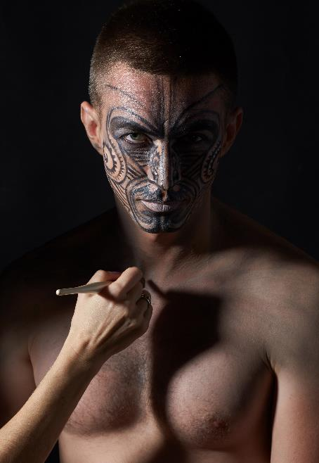
The arts and wellbeing
Young people are increasingly seeing the benefits of the arts to their wellbeing
% who agree that taking part in arts activities helps them feel good about life in general
62%
73%

Slide 23
How the arts make young people feel
Indeed, 79% of young people say the arts makes them feel excellent or good
34%
46%
18%
3%

Slide 24
Reasons why the arts make young people feel good / excellent
I like making things and like writing stories and poems. I feel good when I do a good job and when my teacher says I have done a wonderful job and when I make stuff for my Mum and Dad I feel really good when they tell me that I have done a great job.
Because this is a time when I am allowed to do my own thing and be creative and express emotions and thought into music and theatre. All of these things I love doing and being in my zone is an amazing feeling that brings much joy.
It makes me feel connected and more confident in my culture.

Slide 25
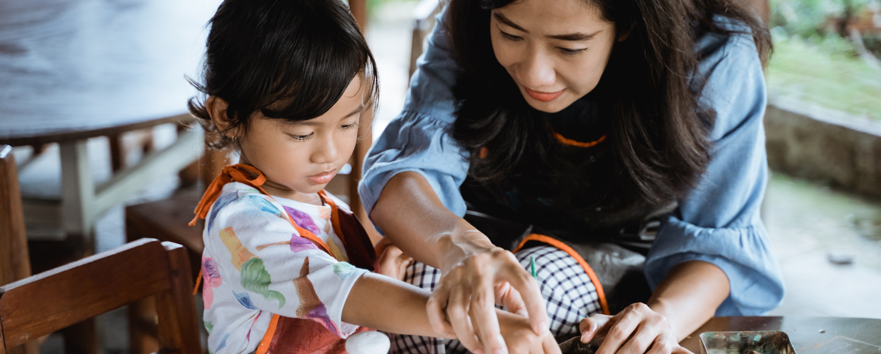
Parental influence on young peoples’ attitudes
Parents are highly influential when it comes to how young people view the arts
A child's perception of their own creativity is closely aligned to how their parent views them. That said, a parent's attitude to the arts does not predetermine the child's.

Slide 26
EDWARD LANGLEY or KATELYNN FULLER

