Slide 1
Profile of Creative Professionals 2022

Slide 2
1

Slide 3
CREATIVE PROFESSIONAL DEFINITION
APPROACH
ACCESSIBILITY
603 online surveys completed with creative professionals
Fieldwork conducted
15 September – 10 October 2022
Those aged 16 plus who earned at least some income from their creative work in the financial year ending 31 March 2022
Email survey invitation available in range of accessible formats
Option for doing the survey over the phone or on a video call with a NZSL interpreter

Slide 4
Who did we speak to?
GENDER
ETHNICITY
305 | 280 | 18
AGE
469 | 109 | 34 | 38
DISABLED
89 | 142 | 156 | 127 | 89
63

Slide 5
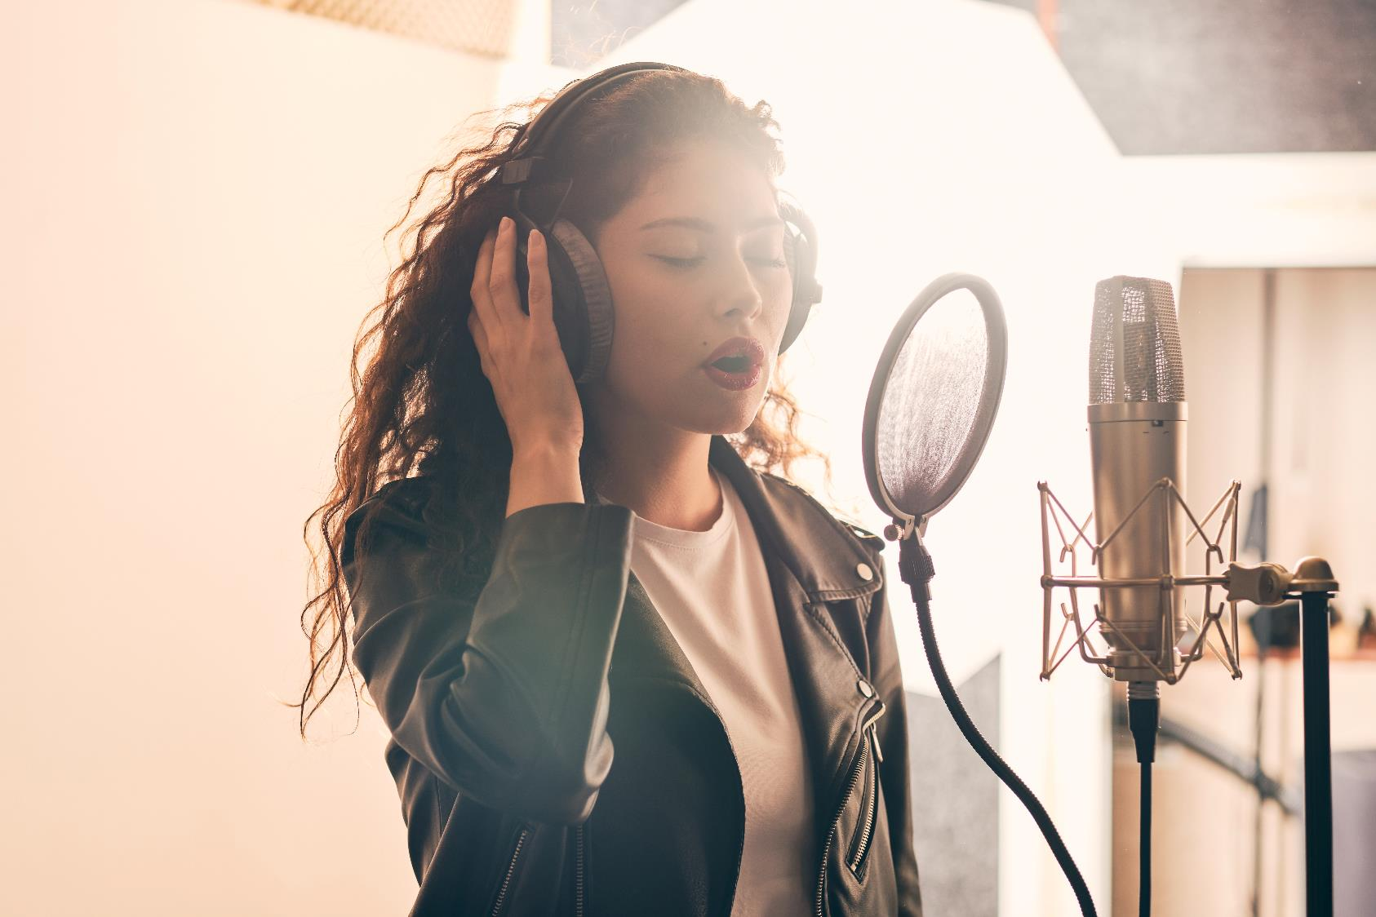
INCOME AND HOURS

Slide 6
How do Creative Professionals compare to the rest of the population when it comes to income?
Creative professionals
Median total income for creative professionals
All New Zealanders
Median income for all New Zealanders earning a wage or salary
Self employed
Median total income for self-employed New Zealanders
$37,000
$61,800
$39,900

Slide 7
Personal income (after expenses) by key demographics
Deaf and disabled creative professionals

Slide 8
Income change since COVID
Q. Which of the following best describes your creative income now, compared to your creative income before COVID entered New Zealand (February 2020)?
Creative income a lot higher than in Feb 2020
Creative income a lot lower than in Feb 2020
38%
40%
 | Creative income slightly higher | Unchanged | Creative income slightly lower
79%
of video game developers say their income is higher now
47%
of music and sound artists say their income is lower now

Slide 9
Comparisons to the 2019 report: income
Compared to 2019, the 2022 group is:
2019
2022
More experienced in their creative field
Median total personal income
$35,800
Median total personal income
$37,000
Older
Slightly more male
Median creative income
$15,000
Median creative income
$19,500
Differs by art form participation.

Slide 10
Perceptions of fairness of remuneration for creative work
Q. How much do you agree or disagree, that your income from your creative career in the financial year ending 31 March 2022 was a fair reward for the time you spent on it?
Strongly disagree
Strongly agree
 | Tend to disagree | Neither agree nor disagree | Tend to agree
More likely to think their creative income is unfair
Deaf and disabled creative professionals
Writing / literary artists
Performing artists
Those who work in the gig economy
Women

Slide 11
Division of work – proportion also undertaking work outside of the creative sector
More likely to also work outside of the creative sector:
Q. In the financial year ending 31 March 2022 did you undertake paid work outside of the creative sector or in a non-creative role?
Music and sound artists
Undertake paid work outside of the creative sector
Creative professionals who are becoming established in their career
Work in the creative sector only
People working in the performing arts
Those who work in the gig economy

Slide 12
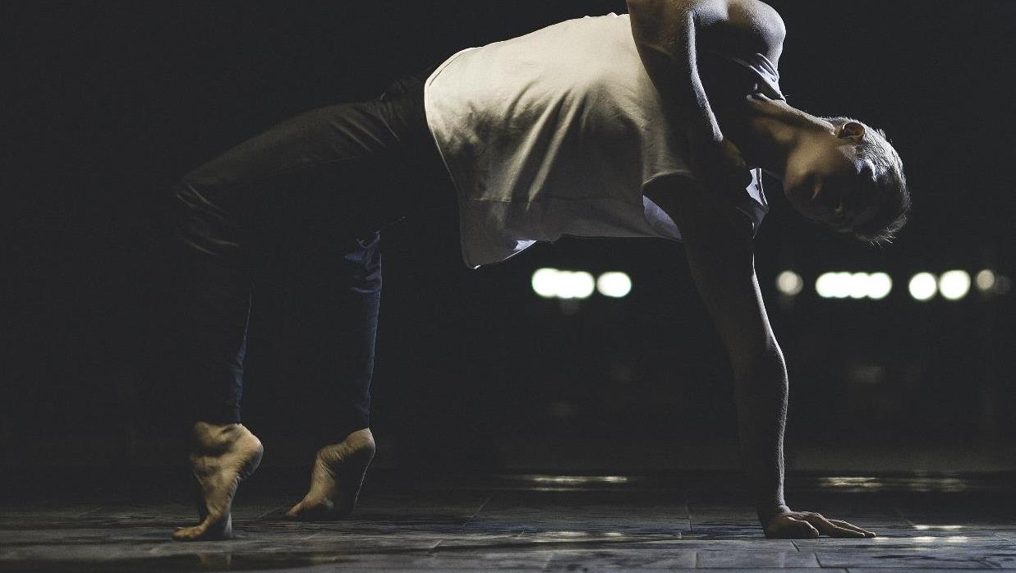
Household income
Median for creative professionals
$87,500
Median all NZ households
$104,700

Slide 13
Living conditions afforded by present income by median household income
Q. Which one of these phrases comes closest to your own feelings about your household income these days?
10%
22%
43%
24%

Slide 14
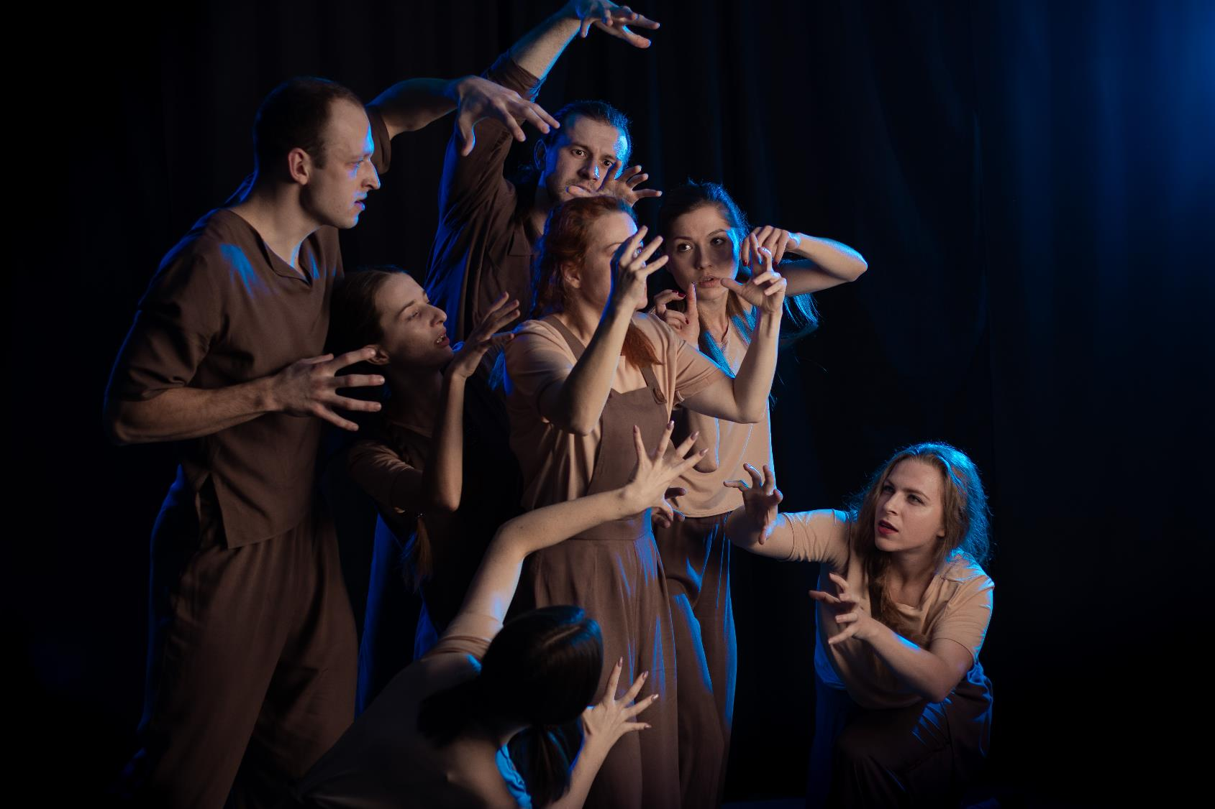
WELLBEING AND CAREER SATISFACTION

Slide 15
Career satisfaction
Q. All things considered, how satisfied are you with your career in the creative sector?
Extremely dissatisfied
Extremely satisfied
0
1
2
3
4
5
6
7
8
9
10
Less satisfied with creative career than average
Finding it very difficult on present income
Asian creative professionals
Beginning creative career
Also working outside of creative sector
Part of the gig economy

Slide 16
The relationship between career satisfaction and wellbeing The higher people’s career satisfaction, the higher their life satisfaction
Extremely dissatisfied with career
Extremely satisfied with career
CAREER SATISFACTION RATING

Slide 17
Burnout
Creative professionals more likely to have experienced burn out in the last year:
Q. Do you think you have experienced burnout over the last year?
Deaf and disabled creative professionals
Don’t know
No, not at all
Younger professionals, aged 16 to 39
Those finding it difficult / very difficult on present income
Yes
Those becoming established in their career
No, but I have come close
Multi-disciplined artists
Those also working outside of the creative sector

Slide 18
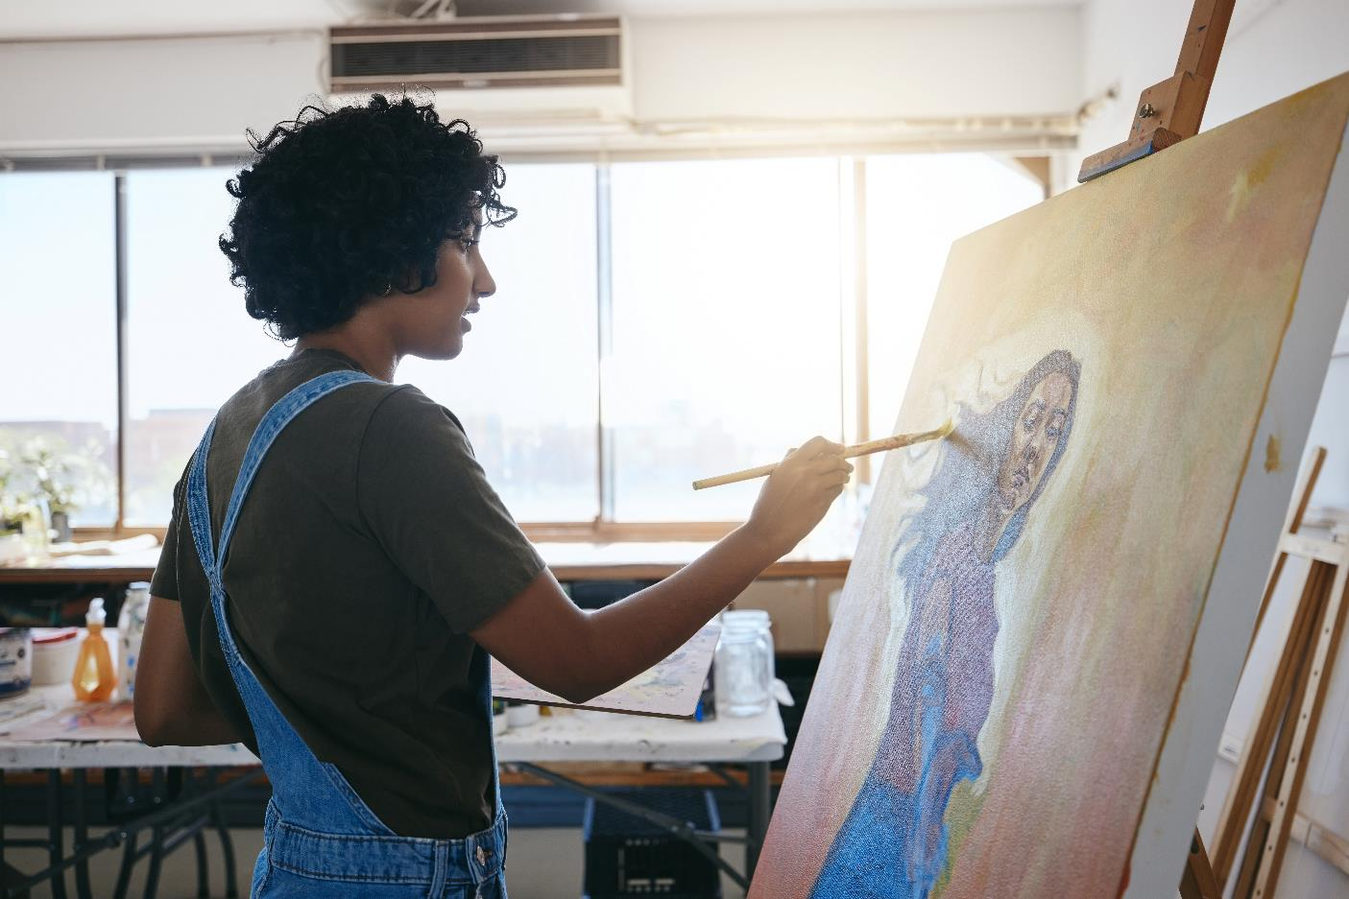
THE GIG ECONOMY

Slide 19
Participation in the gig economy
Q. Would you consider yourself to be part of the gig economy?
71%
of creative professionals consider themselves part of the gig economy

Slide 20
Weighing up the gig economy
Q. How much would you agree or disagree with the following statements about the gig economy?
Disagree
Agree
The gig economy has more downsides than benefits
The gig economy allows me to achieve better work-life balance
I earn more in the gig economy than I would if I had a permanent job

Slide 21
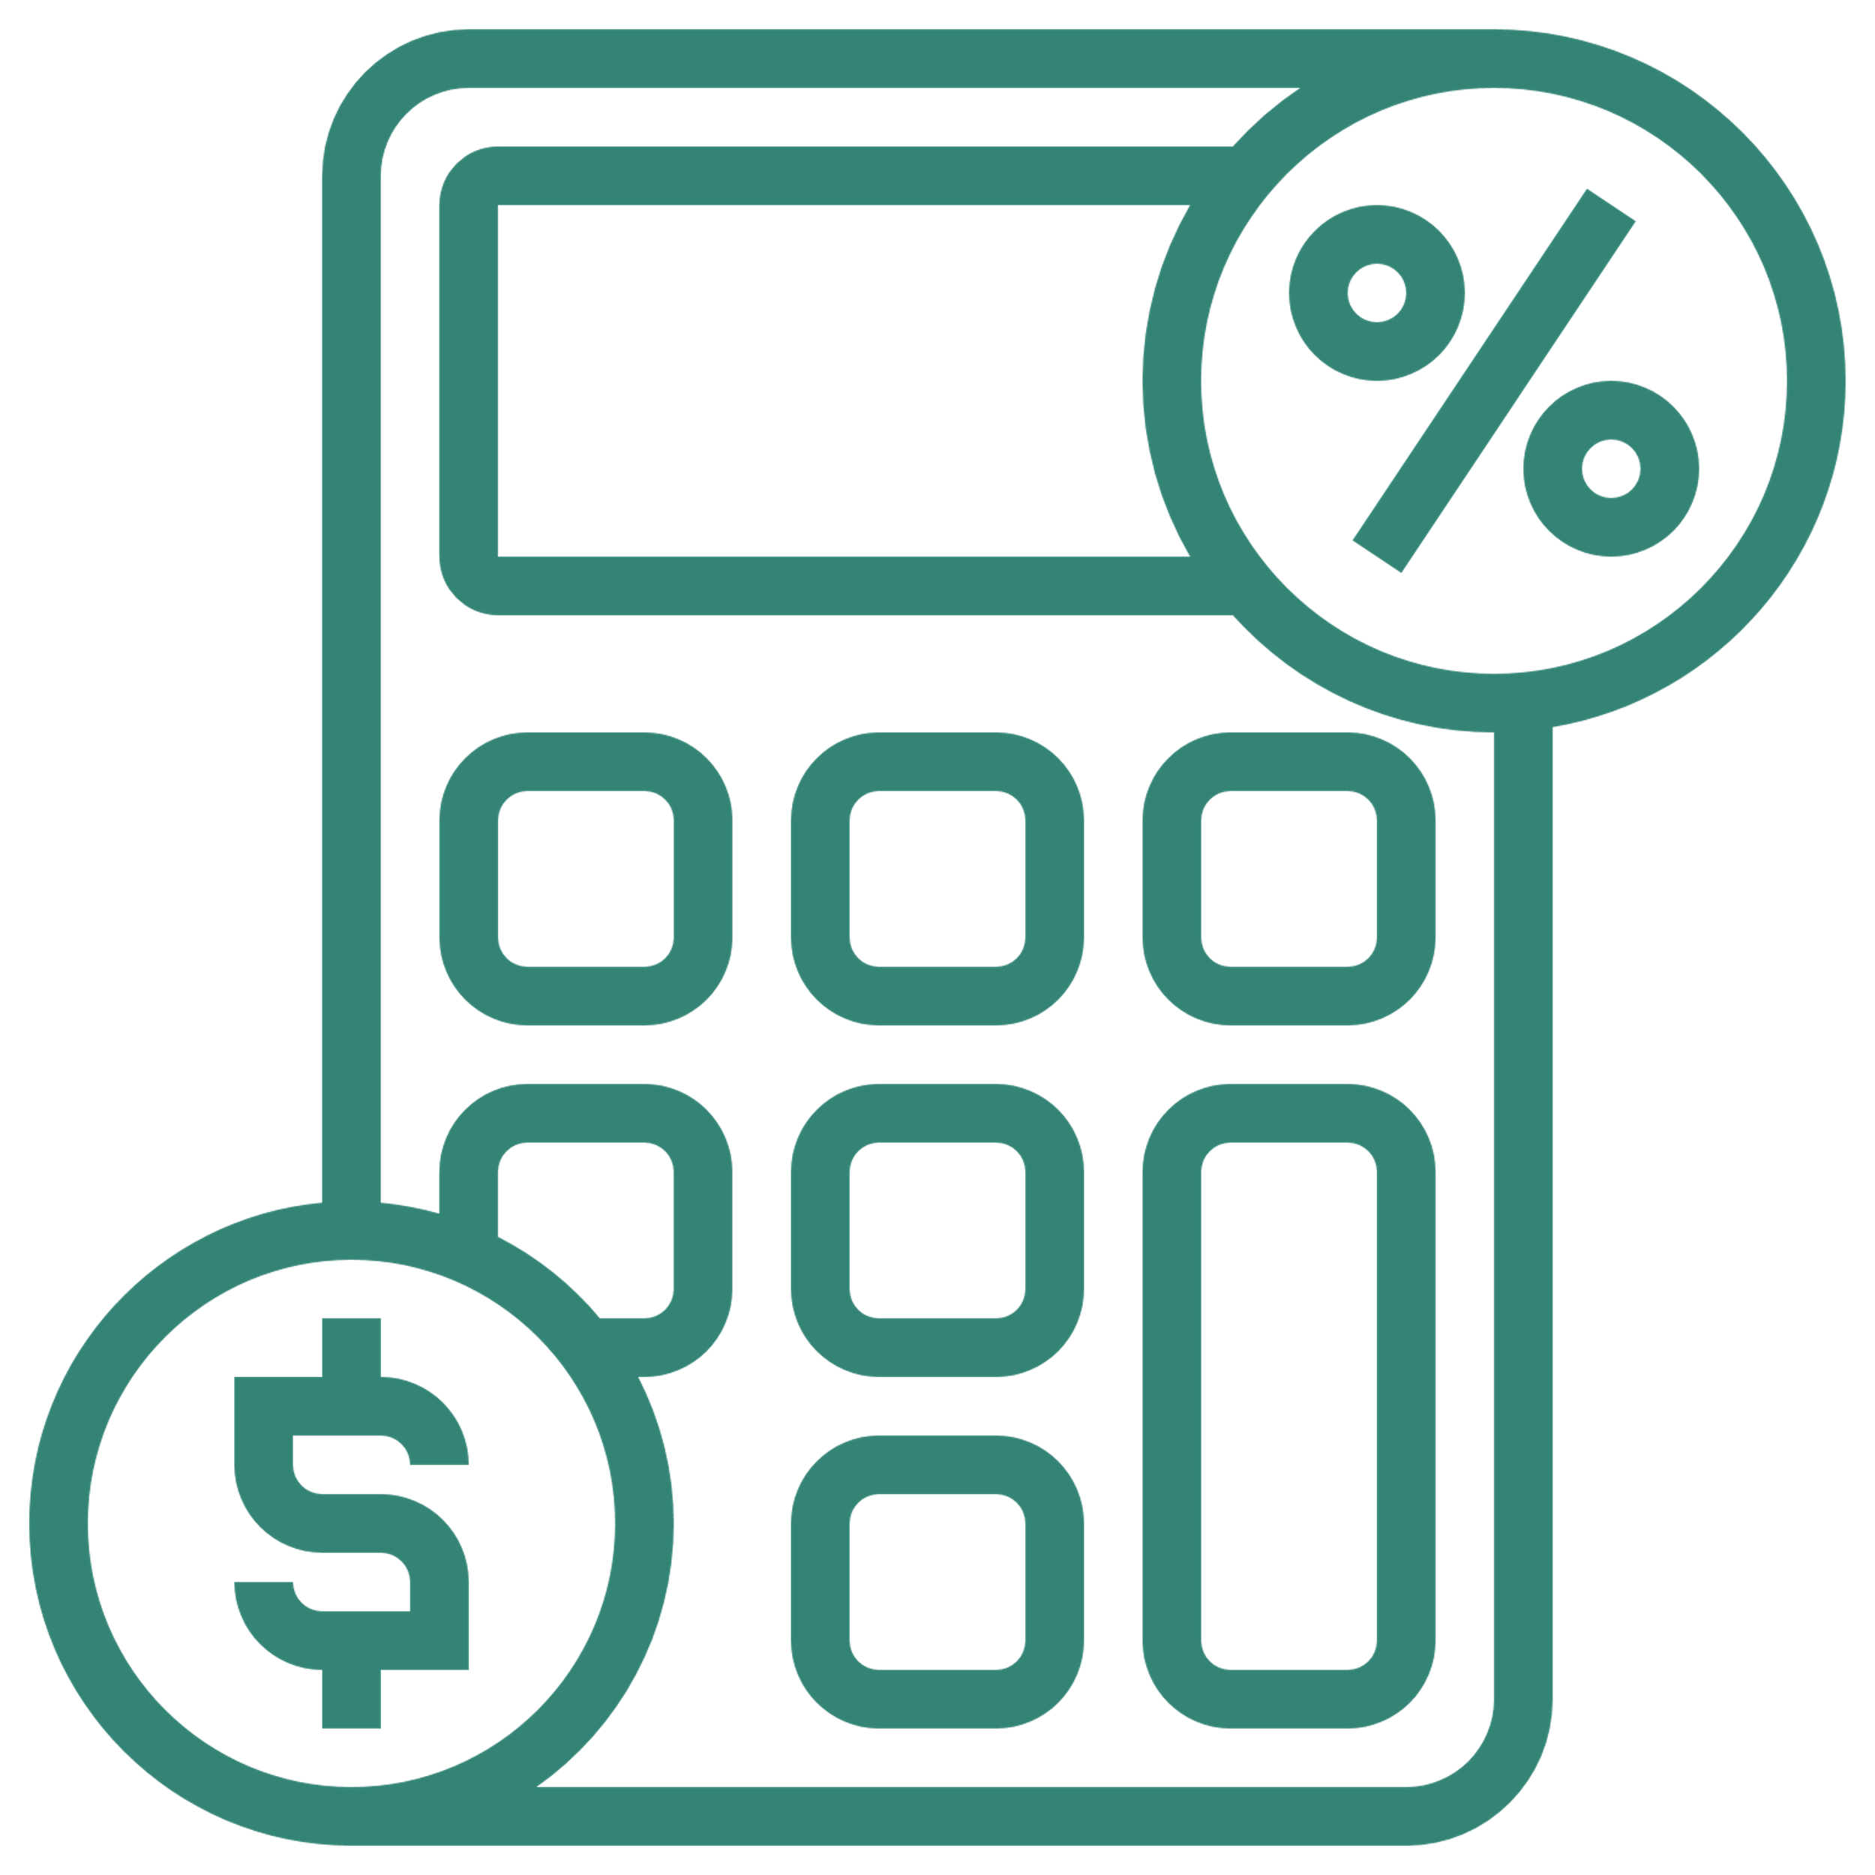
Challenges of the gig economy
Q. How easy or difficult do you find the following aspects of the gig economy? (% very / quite difficult)

Slide 22
6

