Slide 1
Profile of Creative Professionals
November 2022

Slide 2
Acknowledgments
Creative New Zealand Toi Aotearoa, NZ On Air Irirangi Te Motu and Kantar Public would like to thank all the creative professionals who took part in the survey, and the following arts organisations that supported the research: Arts Access Aotearoa, Te Matatini, Te Māngai Pāho, Te Taumata Toi-a-iwi and members of The G8 including the G8, Te Tairāwhiti Arts Festival, Taki Rua, Kia Mau Festival and Te Pou.

Slide 3
1. Key findings |  | 6
2. Income and hours |  | 8
3 Personal income | 10
4 Hours worked | 18
5 Household income | 25
6. Wellbeing and career satisfaction |  | 31
11. The gig economy | 55
12. Contractual arrangements and understanding of Intellectual Property | 60
13. Glossary | 64
14. Appendix | 66
Contents
7. Opportunities in Aotearoa New Zealand |  | 38
8 Career prospects | 40
9 Development and training opportunities | 44
10 Overseas experience | 51

Slide 4
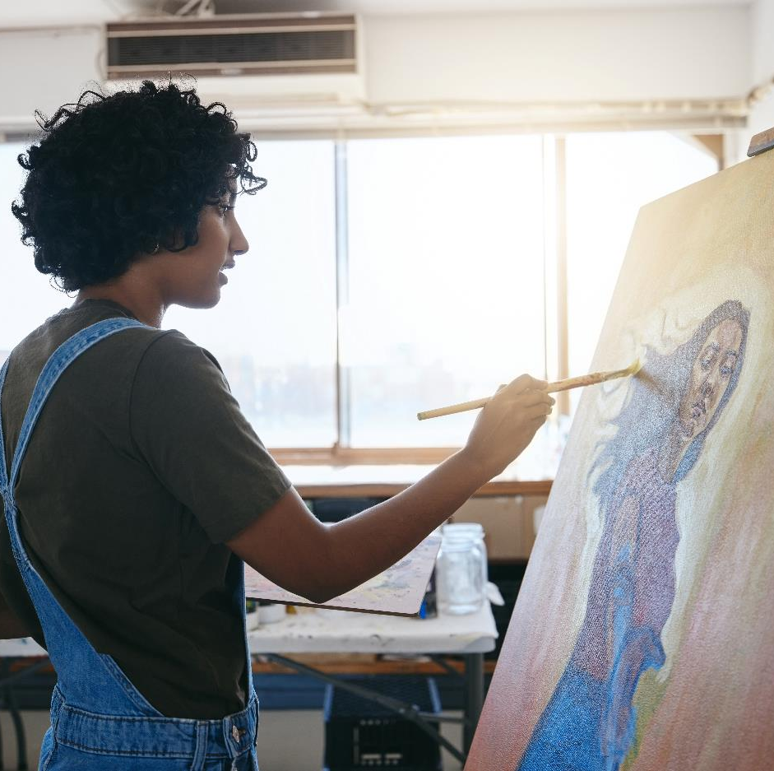
Background and objectives of the research
PICTURE
Creative New Zealand and NZ On Air jointly commissioned Kantar Public to conduct research into the sustainability of careers in the creative sector, and opportunities to better support creative professionals in their careers. This research was last carried out in late 2018, and the current report represents an updated snapshot of the sector.
The 2022 findings are not compared to those findings in the 2019 report. This is because the sample composition differs somewhat between the two years, with a more experienced group of professionals responding to the survey this year. Differences in sample composition mean we can not be sure whether changes observed between the two years are real, or because we are talking to two slightly different groups of creative professionals.
What do we mean by Creative Professionals?
Creative professionals have been defined in the research as those aged 16 plus, who earned at least some income from their creative work in the financial year ending 31st March 2022.
Creative professionals working in the following creative sectors were included in the research: craft and object arts, community arts, literary arts, media production, music and sound, ngā toi Māori, Pacific arts, performing arts, video game development, and visual arts. Please see Glossary for a list of roles included under each profession.

Slide 5
Methodology
603
Online surveys were completed
(this has a maximum margin of error of +/-4.0 percentage points)
Fieldwork dates
15 September – 10 October 2022
Approach
Sampling
Notes to the reader
The research was conducted online. Participants either received an open link, or were sent an unique link to the survey via email.
The email survey invitation was available in New Zealand Sign Language (NZSL) video, Plain Language, Large Format, Easy Read and Braille formats. People were given the option of doing the survey over the phone or on a video call with a NZSL interpreter.
Our target respondents for this study were Creative Professionals aged 16 plus, who earned at least some income from their creative work in the financial year ending 31 March 2022. To qualify for the survey participants also had to be either a Permanent Resident or Citizen of New Zealand.
To ensure that a broad range of creative professionals were included, the sample was constructed from a list sourced from Creative New Zealand, while NZ On Air sent out the invitation as an open link to those on their relevant mail lists. Several arts organisations also circulated an open link to the survey, including: Arts Access Aotearoa, Te Matatini, Te Māngai Pāho, Te Taumata Toi-a-Iwi and Members of The G8. This was done to try and ensure Deaf and disabled creative professionals, and those with Māori, Pasifika and Asian whakapapa were adequately represented in the survey.
Please see Appendix for the demographic profile of the sample.
The report presents findings by artform. Some creative professionals work across multiple artforms. At points the report focuses on a professional’s principal creative occupation (PCO). Where creative professionals have multiple creative occupations, it is the one they most strongly identify with.
The report details the median income for creative professionals as opposed to the mean income. The median is the ‘mid-point’ in the distribution of incomes. It provides a more accurate view of the ‘average income’ than the mean which can be distorted by outliers in the data (i.e. high income earners). All income figures have been rounded to the nearest hundred.
With the exception of income, any differences between subgroups that are noted in the report are statistically significant at the 95% confidence level. This means that we are 95% confident that the observed difference is real and not simply a chance result. Median figures cannot be tested for statistical significance.
Stock images have been used throughout the report.

Slide 6
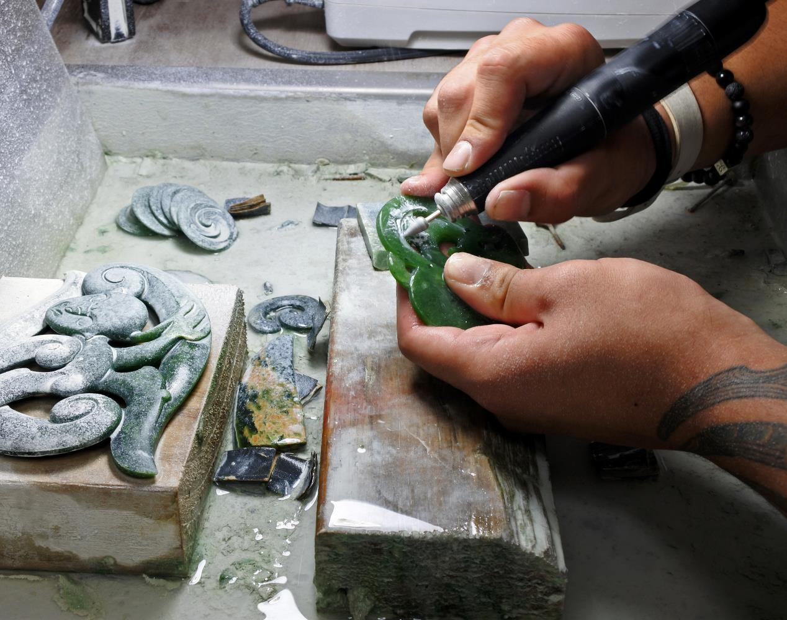
1
Key findings

Slide 7
Key findings from the research
The median total income for Creative Professionals is $37,000 per annum and the median income for creative work is $19,500
Half of creative professionals are satisfied with their creative career, but many find their financial situation difficult and feel burnt out
The gig economy has more downsides than benefits for creatives
The median income for Creative Professionals is $37,000. This is comparable to what self-employed New Zealanders earn ($39,900*), but considerably lower than the median income for those earning a wage or salary ($61,800*).
The median income for creative work is $19,500. This is lower than total income as nearly half of creative professionals also hold down a job outside of the sector to supplement their income.
Overall, only 18% of creative professionals agree they are fairly compensated for their time, with two thirds indicating that they do not feel fairly compensated. Women and Deaf and disabled creative professionals are more likely to agree they aren’t fairly compensated. Indeed, men in the creative sector get paid 32% more than women. Deaf and disabled creative professionals are also paid less than average. Note this analysis does not take into account other factors that could influence earning.
Fifty-three percent of creative professionals are satisfied with their creative career. Those who are satisfied most often say it’s because it is creatively satisfying, they love what they do, and they are good at it.
The main reason given for career dissatisfaction is low and inconsistent income. Indeed, only a quarter of creative professionals are living comfortably on their present income. Forty-three percent say they are getting by, but the remaining third are finding their financial situation challenging.
Half of creative professionals say they have experienced burnout in the past year, and a further 27% say they have come close. Burnout is more common among those who are finding it difficult on their current income. They tend to be younger, less established creatives, holding down multiple roles in and out of the sector.
Most creative professionals (71%) consider themselves to be part of the gig economy. However, participation in the gig economy is much lower among those working in video game development (20%).
Four in ten creative professionals agree the gig economy has more downsides than benefits, with only 19% saying otherwise. Further, 60% feel they would earn more if they had a permanent job.
Almost all (94%) creative professionals participating in the gig economy find it difficult to secure loans for things like mortgages, and four in five find it difficult to predict how much money they are going to make, and struggle with the lack of holiday and sick pay.
*Stats NZ 2022

Slide 8
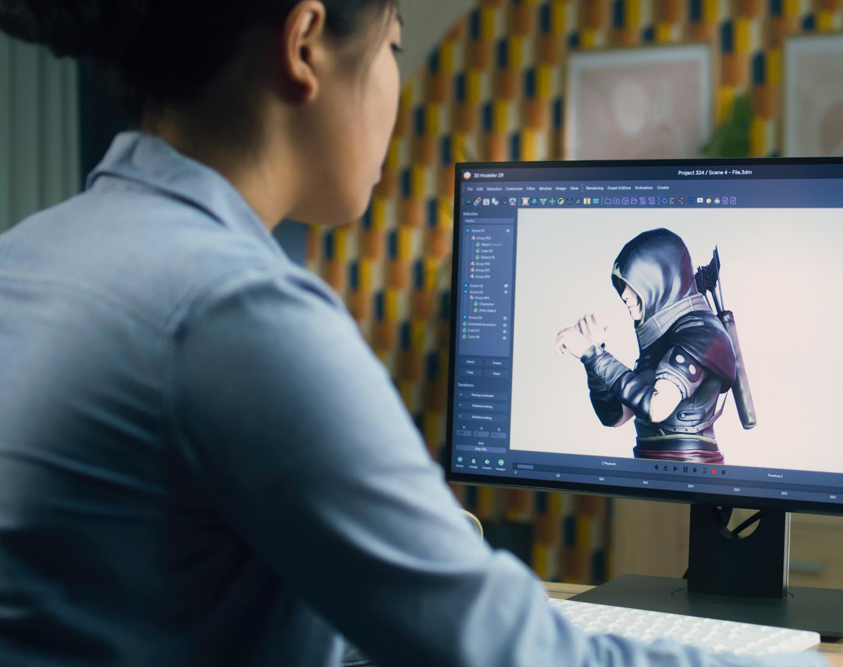
2
Income and hours

Slide 9
Summary: Income and hours worked
The median personal income (after expenses) for Creative Professionals is $37,000, this compares to $39,900 for self-employed New Zealanders, and $61,800 for all New Zealanders earning a wage or salary.
In total, only 18% of creative professionals agree they are fairly compensated for their time, with two thirds indicating that they do not feel fairly compensated.
Video game developers and those involved in media production earn considerably more than the median. On the other hand, those working in community arts, writing and literary arts, music and sound, and craft and object arts earn notably less.
The impact of COVID has been felt differently across art forms. Seventy-nine percent of video game developers say their income is higher now than it was in February 2020. On the other hand, 47% of music and sound artists say their income is lower.
On average, men in the creative sector get paid 32% more than women. Deaf and disabled creative professionals are also paid less than average. It’s important to note, however, that this analysis does not take into account other factors that could influence earning.
Fifty-six percent of creative professionals work exclusively in the creative sector. On average, they work a total of 45 hours a week. Those who also work outside of the sector work 40 hours a week on average, spending 24 hours on creative work and the rest on non-creative endeavours.
Roughly 40% of creative professionals are spending less time on their career than they would like. One of the main reasons for this is being unable to earn enough from creative work alone. Nearly half have work commitments in non-creative roles, and 45% say continuous work simply hasn’t been available due to COVID.
The median household income for creative professionals is $87,500, this is well behind the median household income for all New Zealand households ($104,700).
Two thirds of creative professionals are comfortable or getting by on their current income. However, this still leaves a third who are finding their financial situation difficult.
PERSONAL INCOME
HOURS
HOUSEHOLD INCOME
DIFFERENCE IN INCOME
Median as opposed to mean incomes are reported. The median provides a more accurate view on how much creative professionals earn, this is because it takes into account any outliers in the data.
All income figures have been rounded to the nearest hundred.

Slide 10
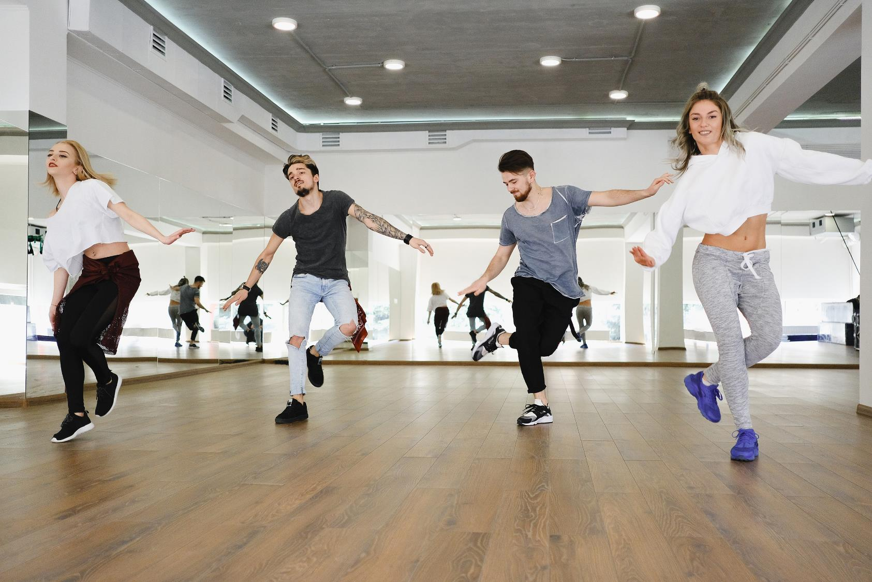
3
Personal income

Slide 11
Total income
The median income for Creative Professionals is $37,000. This is substantially less than the median income for those New Zealanders earning a wage or salary ($61,800*), but comparable to what self-employed New Zealanders earn ($39,900*).
All New Zealanders
Median income for all New Zealanders earning a wage or salary
Self employed
Median total income for self-employed New Zealanders
Creative professionals
Median total income for creative professionals
$61,800*
$39,900*
$37,000
NOTE: All income information is before tax and after expenses.
Source: F10B F10C F10D F11 F12 F13 | *Stats NZ 2022
Base: All participants that had provided answers in the income section | Total income, after expenses (n=454)

Slide 12
Total income, after expenses
Two thirds of creative professionals earn less than $50,000 a year. Median creative income is $19,500, this is lower than total income because 44% of creative professionals supplement their income by also working outside of the creative sector.
Total personal income, after expenses
MEDIAN
$37,000
Total creative income, after expenses
MEDIAN
$19,500
Source: F10B F10C F10D F11 F12 F13
Base: All participants that had provided answers in the income section (n=454)

Slide 13
Income change since COVID
Thirty-eight percent of creative professionals say their creative income has increased since COVID entered New Zealand in February 2020. However, roughly the same proportion (40%) say their income has declined, with a fifth saying it is a lot lower than it was. Some art forms have fared better than others, this is likely to do with how important live audiences are to each. Indeed, 79% of video game developers say their income has increased, while nearly half of music and sound artists say they are now on a lower income.
38% of creative professionals have a higher income now than pre-COVID
40% of creative professionals have a lower income now than pre-COVID
Creative income a lot higher than in Feb 2020 | Creative income slightly higher | Unchanged | Creative income slightly lower | Creative income a lot lower than in Feb 2020
Differences by art form
of video game developers say their income is higher now than it was in February 2020.
79%
47%
of music and sound artists say their income is lower now than it was in February 2020.
Source: F15a. Which of the following best describes your creative income now, compared to your creative income before COVID entered New Zealand (February 2020)?
Base: Total (n=581). Excludes don't know responses.

Slide 14
Personal income (after expenses) by artform
Creative professionals working in video game development, media production and ngā toi Māori earn more than the median. On the other hand, those working in community arts, writing and literary arts, music and sound, and craft and object arts earn notably less.
Video game development
(n=53)
Media production
(n=115)
Ngā toi Māori
(n=49)
Pacific arts
(n=12)*
Visual arts
(n=107)
$37,000
$66,000
$46,800
$42,500
$38,500
$37,000
Total
(n=454)
Performing arts
(n=137)**
Community arts
(n=64)
Writing / literary arts
(n=80)
Music and sound
(n=115)
Craft / object arts
(n=59)
$36,500
$33,200
$32,700
$28,800
$25,200
*Small base size, interpret with caution.
**Performing arts combines acting and theatre production with dance. When split out, acting and theatre production artists earn a median of $36,500 per year, while dancers earn a median of $33,500. Note, the sample size for dancers is low (n=26), please interpret these findings with caution.
Source: F10B F10C F10D F11 F12 F13 | Base: All participants that had provided answers in the income section. Sample sizes on chart.

Slide 15
Personal income (after expenses) by key demographics
On average, men in the creative sector get paid 32% more than women. The difference in creative income is similar (33%). The pay gap in the creative sector is more extreme than at the national level (9.2%*). Note, this measure does not consider factors that could influence differences in earnings such as art form, qualifications, age and hours worked. Deaf and disabled creative professionals are also paid less than the median for both their total and creative income, as are people aged 60 years or over. Again, other factors that could influence earnings have not been accounted for.
Total income, after expenses
Deaf and disabled creative professionals
(n=45)
Total creative income, after expenses
Deaf and disabled creative professionals (n=45)
Note: Income for Asian New Zealanders and Pacific peoples has not been reported due to low sample size
Source: F10B F10C F10D F11 F12 F13 | *Stats NZ 2022
Base: All participants that had provided answers in the income section.

Slide 16
Perceptions of fairness of remuneration for creative work
Sixty-eight percent of creative professionals do not think they are being fairly remunerated for their work. Those who feel this way are more likely to be dissatisfied with their career, and feel they may exit the creative sector within the next five years. They are more likely to be working in the literary and performing arts, and also holding down a role outside of the creative sector. Additionally, Deaf and disabled creative professionals and women are more likely to feel their remuneration is unfair; reflecting lower income levels for these groups (see previous slide). On the other hand, video game developers and ngā toi Māori artists are more likely than average to feel fairly rewarded for their work.
More likely than average (68%) to disagree that creative income was a fair reward for time spent:
Dissatisfied with their career (87%)
Deaf and disabled creative professionals (79%)
Unlikely to be in the creative sector in 5 years (77%)
Those working in writing / literary arts (76%)
Also working outside of the creative sector (75%)
Those working in the performing arts (74%)
Women (73%)
Working in the gig economy (72%)
More likely than average (18%) to agree that creative income was a fair reward for time spent:
Video game developers (39%)
Ngā toi Māori artists (30%)
Satisfied with their career (27%)
Established professionals (22%)
Source: F15. How much do you agree or disagree, that your income from your creative career in the financial year ending 31 March 2022 was a fair reward for the time you spent on it?
Base: Total (n=594). Excludes don't know responses.

Slide 17
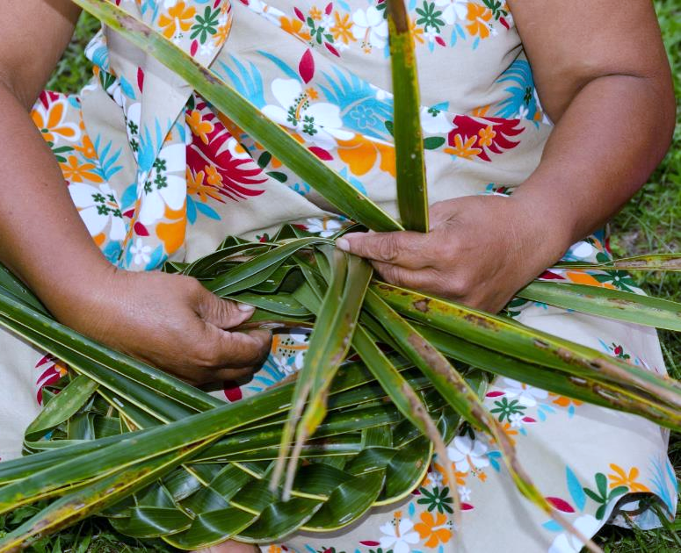
Perceptions of fairness of remuneration for creative work by creative income
$27 per hour is the level at which creative professionals start to feel their remuneration is fair. Those who disagree their income is fair are earning well below the New Zealand minimum wage at the time ($20.00).
Median hourly creative income
Remuneration is a fair reward for the time spent
Source: F10B F10C F10D F11 F12 F13 F5 F5A F15
Base: All participants that had provided answers in the income section.

Slide 18
4
Hours worked

Slide 19
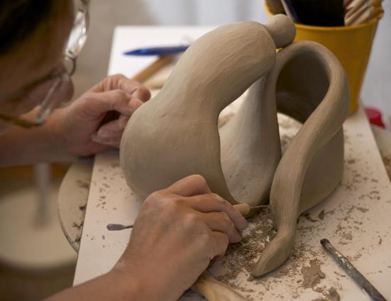
Division of work
Fifty-six percent of creative professionals only work within the creative sector, meaning that 44% also undertake paid work outside of the sector. Those engaging in work outside of the sector are more likely to work in music and sound, and the performing arts. They also tend to be in the earlier stages of their career and working in the gig economy.
More likely than average (44%) to also work outside of the creative sector:
Music and sound artists (58%)
Creative professionals who are becoming established in their career (55%)
People working in the performing arts (54%)
Those who work in the gig economy (50%).
Undertake paid work outside of the creative sector,
44%
Work in the creative sector only, 56%
Source: F3. In the financial year ending 31 March 2022 did you undertake paid work outside of the creative sector or in a non-creative role? Base: Total (n=603).

Slide 20
Hours worked
Creative professionals who only work in the creative sector spend an average of 45 hours a week on their work. Those who also do work outside of the sector are working an average of 40 hours in total, with just over half of their time spent on creative work (24 hours).
Creative professionals who only work in the creative sector (56%)
Mean
45
Creative professionals who also do work outside of the creative sector (44%)
Mean
40
24
Note: The mean, rather than the median, has been used here because there is a maximum number of hours in a week, therefore limiting the potential for outliers to impact the results. Indeed, respondents were not allowed to enter an answer greater than 168 hours | Source: F5. How many working hours would you say you did in a typical week in the financial year ending 31 March 2022? | F5A. In the year ending 31 March 2022, how many hours per week did you spend doing creative work on average? | Base: Creative professionals who only work in the creative sector (n=303); creative professionals who also do work outside of the creative sector (n=227).

Slide 21
Median income per hour by artform
The median income per hour for creative professionals is $25. This is nearly five dollars less than the median hourly earnings for working New Zealanders ($29.67*). There is substantial variation in pay between the different creative sectors, those working in video game development and media production earn the most per hour, while those working in the performing arts, writing and literary arts and community arts earn the least.
Video game development
(n=53)
Media production
(n=109)
Music and sound
(n=108)
Ngā toi Māori
(n=47)
Pacific arts
(n=10)***
$25.00
$32.20
$27.30
$24.90
$24.00
$23.60
Total
(n=431)
Visual arts
(n=104)
Craft / object arts
(n=57)
Performing arts
(n=124)**
Writing / literary arts
(n=74)
Community arts
(n=61)
$23.20
$23.20
$21.40
$21.20
$21.20
Source: F10B F10C F10D F11 F12 F13 F5 F5A | *Stats NZ 2022 | **Performing arts combines acting and theatre production with dance. When split out, acting and theatre production artists earn a median of $21.40 per hour, while dancers earn a median of $20.70. Note, the sample size for dancers is low (n=25), please interpret these findings with caution.
Base: Sample sizes on chart. ***Small base size, interpret with caution | Income per hour calculated where both income and hours per week were available, bases are therefore smaller for income per hour than for total income

Slide 22
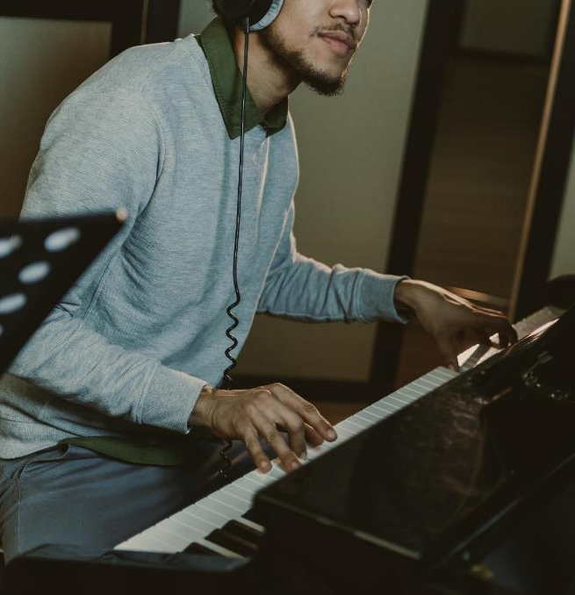
Satisfaction with amount of time spent on creative career
Thirty-nine percent of creative professionals are spending less time than they would like on their creative career. These individuals are more likely to be in the earlier stages of their career, be part of the gig economy and be supplementing their income with work outside of the creative sector. They are also more likely to be music and sound artists or working in the performing arts.
Creative professionals who are more likely than average (39%) to want to spend more time on their creative career include those:
Also working outside of the creative sector (62%)
Becoming established (52%)
working in music and sound (50%)
working in the performing arts (46%)
working in the gig economy (43%).
Pic
27%
spend more time than they would like
39%
spend less time than they would like
Source: F8. Which of the following best describes the amount of time you spent on your creative career in the financial year ending 31 March 2022?
Base: Total (n=591). Excludes don't know responses.

Slide 23
Satisfaction with hours by median number of hours spent working in the creative sector
Creative professionals who feel they spend about the right amount of time on their creative careers spend an average of 37 hours per week doing creative work. This is roughly equivalent to a standard full-time working week in New Zealand.
Mean number of creative hours per week
Source: F8 F5 F5A
Base: Total (n=603). Excludes don't know responses.

Slide 24
Barriers to spending more time on creative career
For those spending less time on their creative career than they would like, the biggest barriers are insufficient income, other work commitments in non-creative roles and continuous work not being available due to COVID. Domestic responsibilities and a general lack of time are also contributing factors for 34% of professionals.
Source: F9. What, if anything, prevented you from spending more time on your creative career?
Base: All who spent less time on creative career than would have liked (n=229)

Slide 25
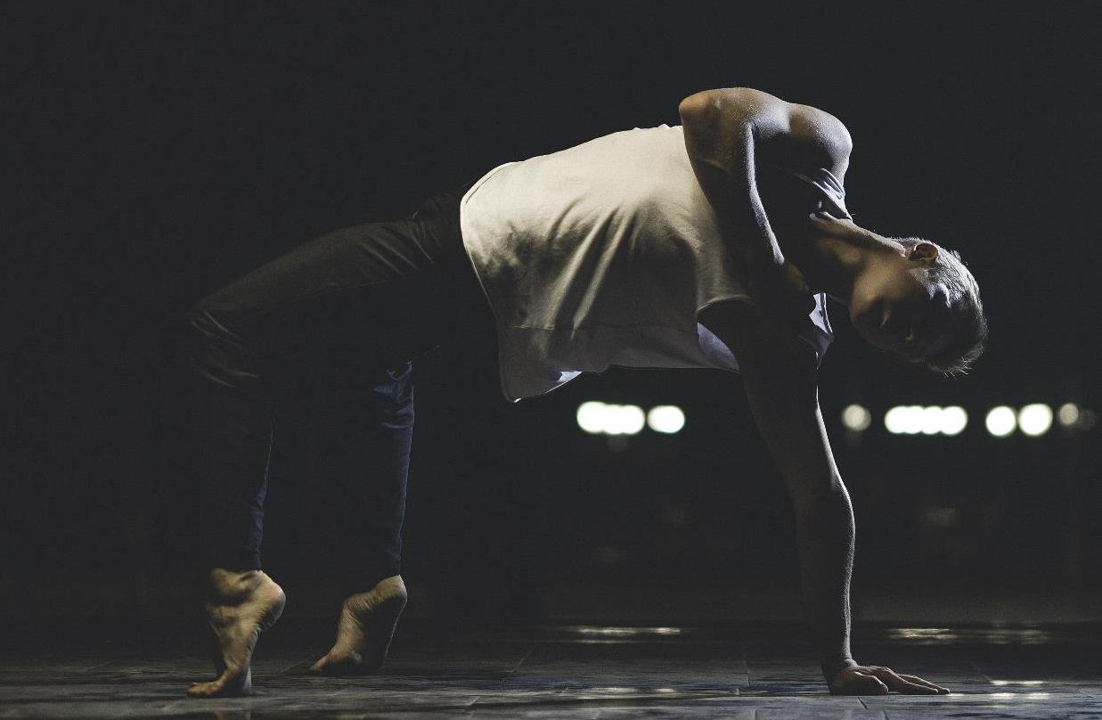
5
Household income

Slide 26
Household income
The median household income for creative professionals is $87,500, this is well behind the median household income for all New Zealand households ($104,700)*.
Household Income
Median
$87,500
Source: F10B F10C F10D F11 F12 F13 G9 G10 | *Stats NZ 2022
Base: All participants that had provided answers in the income section.

Slide 27
Living conditions afforded by present income
A quarter (24%) of creative professionals are living comfortably and a further 43% are getting by on their present income. A third are finding it at least somewhat difficult on their present income, with 10% finding it very difficult.
10%
22%
43%
24%
Finding it very difficult
Finding it
difficult
Getting by
Living comfortably
Source: B3. Which one of these phrases comes closest to your own feelings about your household income these days?
Base: Total (n=603).

Slide 28
Living conditions afforded by present income by household income
Creative professionals living comfortably have a median household income of $140,000, this drops to $95,400 for those simply getting by on their present income. Those finding it very difficult have a median household income of $39,000. This is well under the median household income for all creative professionals ($87,500).
Median household income
Source: F10B F10C F10D F11 F12 F13 G9 G10 B3
Base: All participants that had provided answers in the income section.

Slide 29
Safety nets
Two thirds of creative professionals have at least some form of safety net to protect them from fluctuations in their income; however, a third don’t feel it’s enough. A further third do not have a safety net at all, but only 11% say they do not need one. The most common safety net sources are savings, partners and income from work outside of the creative sector.
Safety net sources
n=591
n=370
Source: F16. Which of the following best describes, whether you have a safety net to protect you? | F17. Who or what provides you with a safety net from earning a low income, or against fluctuations in your income?
Base: Total (n=591). Excludes don't know responses. | Those who have a safety net (n=370)

Slide 30
Support for ideas to provide financial protections
We asked Creative Professionals which of the below ideas would work best to protect them from fluctuations in their income. The idea with the most support is a Basic Income for Creative Professionals (55%), followed by greater funding from Creative New Zealand and NZ On Air (19%). Very few (3%) want to see increases to Government benefits.
55%
19%
9%
3%
Basic income for Creative Professionals
Greater funding for projects from Creative New Zealand / NZ On Air
Expansion of the Research and Development tax incentive (15% tax credit) to include creative expenditure
Increasing Government benefits
6% of respondents said ‘none of the above’, and a further 7% said they ‘don’t know’
Source: F18. Which of the below ideas would work best to protect you from earning a low income or against fluctuations in your income?
Base: Total (n=603).

Slide 31
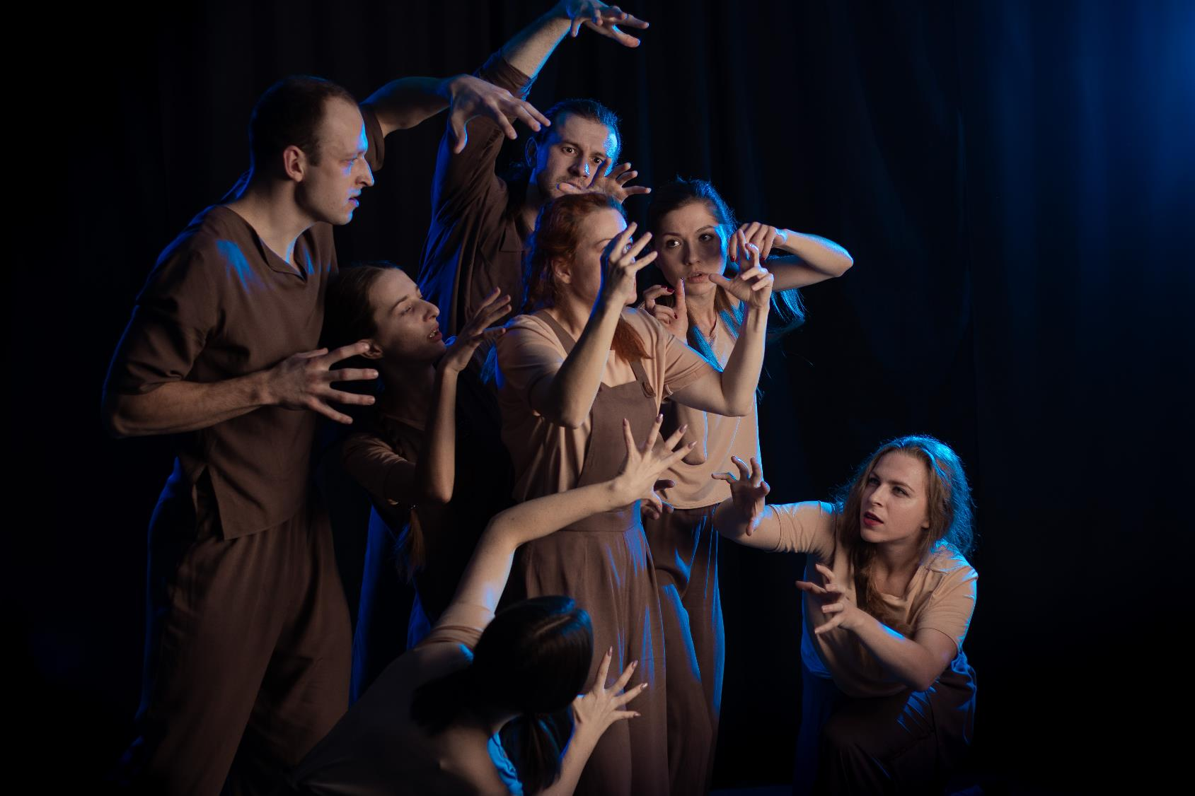
6
Wellbeing and career satisfaction

Slide 32
Career satisfaction
Slightly more than half of all creative professionals are satisfied with their career (rate it 7 to 10 out of 10), and only 11% are dissatisfied (rate their career 0 to 3 out of 10). Creative professionals who are more established in their career, work in the creative sector only, and who live comfortably on their income are more likely to be satisfied with their career. Additionally, Māori creative professionals report higher levels of career satisfaction, while Asian creative professionals have lower levels of satisfaction.
(0) Extremely dissatisfied
Extremely satisfied (10)
53% SATISFIED
Part of the gig economy (48%)
Established in creative career (58%)
Māori creative professionals (69%)
Living comfortably on present income (69%)
Also working outside of creative sector (41%)
Beginning creative career (34%)
Working in creative sector only (62%)
Asian Creative Professionals (30%)
Finding it very difficult on present income (26%)
0%
100%
Less satisfied than average
More satisfied than average
Source: B5. All things considered, how satisfied are you with your career in the creative sector?
Base: Total excluding prefer not to say and don’t know responses (n=599)

Slide 33
Career satisfaction by creative role
Career satisfaction differs notably by artform. Ngā Toi Māori artists and video game developers are amongst those most likely to be satisfied with their career.
Video game development
(n=56)
Ngā toi Māori
(n=63)
Pacific arts
(n=15)*
Community arts
(n=82)
Craft / object arts
(n=77)
Satisfied
(rate career
7 to 10 out of 10)
73%
70%
60%
59%
57%
53%
Total
(n=599)
Visual arts
(n=135)
Media production
(n=158)
Writing / literary arts
(n=109)
Music and sound
(n=171)
Performing arts
(n=175)
55%
51%
50%
50%
47%
= Significantly higher/lower than average | *Small base size, interpret with caution
Source: B5. All things considered, how satisfied are you with your career in the creative sector?
Base: Total excluding Prefer not to say / Don’t know (n=599)

Slide 34
Reasons for satisfaction with creative career
Creative professionals who feel satisfied in their career most often say it’s because it is creatively satisfying, they love what they do, and they are good at it.
“It is rewarding work in an area that interests me.”
“My career is established and I have a good following from my collectors as well as an expanding base of interested followers.”
“I have managed to have some material published, with others in the pipeline; plus I find my research and writing satisfying and useful for others, especially Māori.”
“I love my work, I believe I am helping great music reach more people which also helps the artists. I am privileged to have such a rewarding role.”
“I work as a contractor and I am lucky enough to choose the projects I work on and can fit my work life around a busy family.”
Note: Only themes mentioned by more than 2% shown
Source: B6. Why did you rate your career in the creative sector [insert answer for B5] out of 10?
Base: All who rated career satisfaction 7 to 10 out of 10 at B5 (n=295).

Slide 35
Reasons for dissatisfaction with creative career
Inconsistent income and lack of opportunities are the main reasons for lower career satisfaction among creative professionals.
“Many of the work opportunities I had been expecting have evaporated - mostly because of the impact of COVID, but also because of changes in my broader working environment.”
“Limited work, difficult to find it. Short turn around and low budget and pay rates for short term jobs.”
“I find it very hard to find income and work - I'm trying to get work in the business side of the music industry and it's really hard. Jobs are few and far between, and pay is terrible.”
“…We stay in the arts because it's a labour of love, it's our calling. But there is work ahead for how we can better improve our sector.”
Note: Only themes mentioned by more than 2% shown
Source: B6. Why did you rate your career in the creative sector [insert answer for B5] out of 10?
Base: All who rated career satisfaction 0 to 3 out of 10 at B5 (n=62).

Slide 36
The relationship between career satisfaction and wellbeing
People who are satisfied in their careers are more satisfied with life in general. This means that increasing career satisfaction will improve the wellbeing of creative professionals.
Extremely dissatisfied with career
Extremely satisfied with career
Career satisfaction rating
Source: B5. All things considered, how satisfied are you with your career in the creative sector? |
B1. How do you feel about life as a whole
Base: Total (n=603). Excludes don't know responses.

Slide 37
Burnout
Just over half of all creative professionals have experienced burnout in the past year. Deaf and disabled creative professionals are more likely to have experienced burnout. It is also more common among younger and less established creatives, and those holding down multiple roles.
Don’t know
Creative professionals who are more likely than average (52%) to have experienced burn out in the last year:
Deaf and disabled creative professionals (75%)
Aged 16 to 39 (68%)
Ngā toi Māori artists (67%)
Community artists (66%)
Those finding it difficult / very difficult on present income (65%)
Those becoming established in their career (63%)
Performing artists (62%)
Multi-disciplined artists (59%)
Those also working outside of the creative sector (57%).
No, not at all
Yes
No, but I have come close
Source: F9a. Do you think you have experienced burnout over the last year?.
Base: Total (n=603)

Slide 38
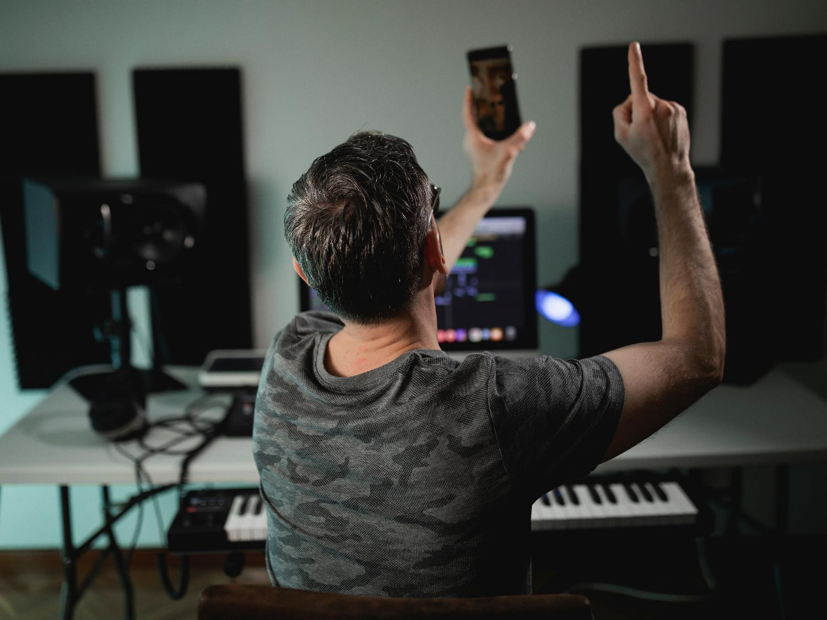
7
Opportunities in Aotearoa New Zealand

Slide 39
Summary: Opportunities in Aotearoa New Zealand
CAREER PROSPECTS
OVERSEAS EXPERIENCE
Over half of creative professionals believe there are not enough opportunities for them to sustain their creative career in New Zealand. Those in the performing arts, and writers and literary artists are even more likely to feel there aren’t enough opportunities for them. In spite of this, four in five (81%) creative professionals are committed to their creative careers, believing they will still be in the sector in 5 years’ time.
Fifty-three percent of creative professionals believe it is necessary to learn from, or work with, overseas-based creative professionals to sustain their career. Although older creative professionals are less likely than average to believe this.
In total, two thirds of creative professionals have spent time collaborating with overseas creatives to sustain their career. This includes both spending time overseas (44%) and online (34%). The top three benefits of doing this are more experience, new contacts, and new ideas and inspiration.
DEVELOPMENT AND TRAINING OPPORTUNITIES
Only a third of creative professionals believe there are enough training and development opportunities for them in New Zealand. Those who don’t believe there are enough opportunities would like to see more mentoring, workshops and higher education available to them.
Creative professionals would also like more support to develop their business skills. They are most likely to mention marketing (39%) and business management (35%) as key areas for development.

Slide 40
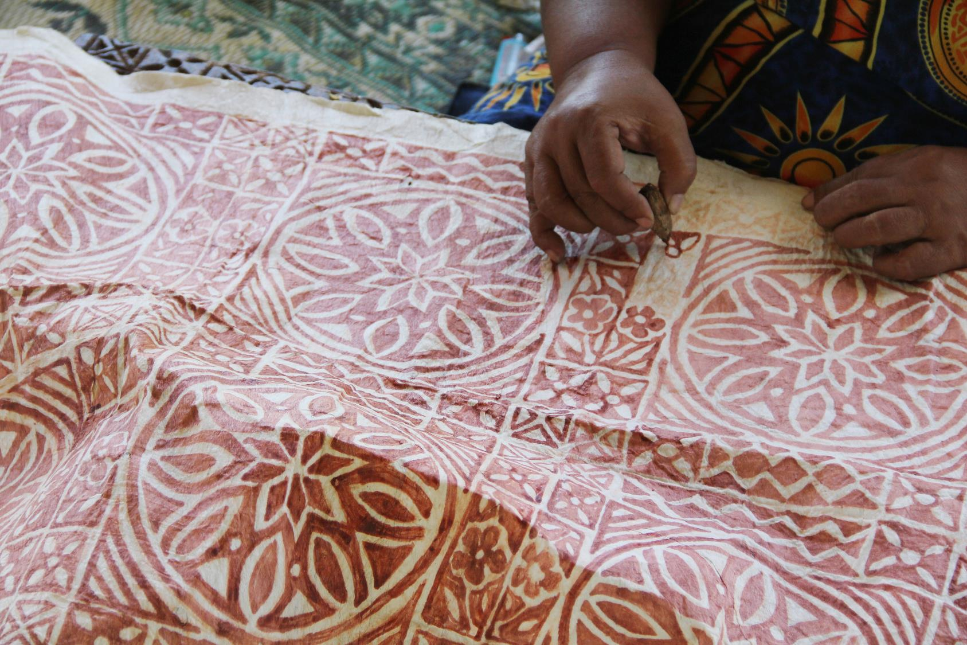
8
Career prospects

Slide 41
Perceived sustainability of creative careers in New Zealand
Over half (55%) of creative professionals believe there are not enough opportunities available for them to sustain their creative career in New Zealand. Those becoming established in their career are more likely than average to say there are not enough opportunities.
More likely than average (55%) to disagree with the statement ‘there are sufficient opportunities for you to sustain a career in New Zealand’:
Dissatisfied / neutral toward creative career (72%)
Finding it difficult very difficult on present income (70%)
Also working outside of cerative sector (66%)
Not committed to creative sector (65%)
Wellington residents (64%)
Becoming established in creative career (64%).
More likely than average (26%) to agree with the statement ‘there are sufficient opportunities for you to sustain a career in New Zealand’:
Living comfortably on present income (40%)
Satisfied with creative career (40%)
Working inside creative sector only (35%)
Not part of gig economy (33%)
Established in creative career (31%)
Committed to the creative sector (28%).
NOTE: PCO stands for principal creative occupation, see ‘notes to reader’ on slide 5 for further explanation
Source: B8. How much do you agree or disagree that there are sufficient opportunities for you to sustain a career in New Zealand as a [PCO]? Base: Total (n=603).

Slide 42
Perceived sustainability by principal creative occupation
Those who have their principal creative occupation (PCO) within the performing arts, and writing and literary arts are more likely than average to say there are not enough opportunities for them in New Zealand, while those whose PCO lies in media production are less likely to feel this way.
= Significantly higher/lower than average | NOTE: PCO stands for principal creative occupation, see ‘notes to reader’ on slide 5 for further explanation. | *Small base size, interpret with caution, Pacific arts not included because base size too small
Source: B8. How much do you agree or disagree that there are sufficient opportunities for you to sustain a career in New Zealand as a [PCO]? | Base: Total (n=603).

Slide 43
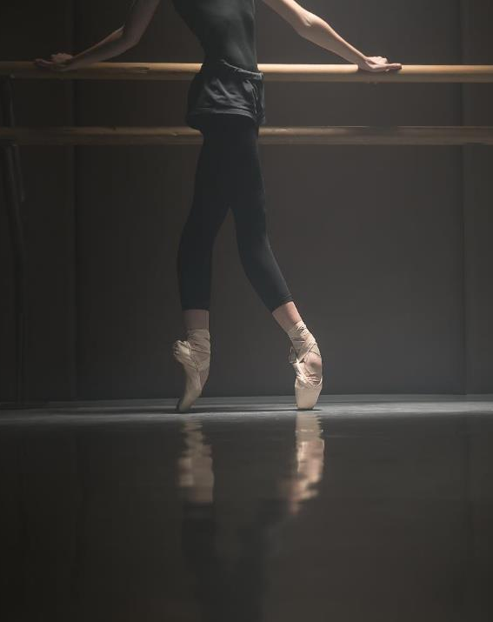
Commitment to the creative sector
Eighty-one percent of creative professionals see themselves in the creative sector in five years’ time; however this does leave a fifth who think they might exit the sector. Creative Professionals more likely to exit the sector include Auckland residents, people aged 40 to 49, those finding it difficult to live on their income, and those who are dissatisfied with their creative career.
More likely than average (81%) to be committed to the creative sector:
Video game developers (93%)
Satisfied with creative career (89%)
Teachers / instructors in the creative sector (88%)
Those living comfortably on their present income (88%).
81%
Of creative professionals see themselves in the creative sector in 5 years’ time
Less likely than average (81%) to be committed to the creative sector:
Auckland residents (76%)
Aged 40 to 49 (73%)
Those finding it difficult / very difficult to live on present income (72%)
Dissatisfied with creative career (47%).
Source: B7. Do you see yourself in the creative sector in 5 years' time? Base: Total (n=603).

Slide 44
9
Development and training opportunities

Slide 45
Skills seen as important for a career in the creative sector
Creative thinking and talent are seen as the top two most important skills to build a successful creative career. The next most important are soft skills, such as networking, communication and being able to self-promote. Business skills are less likely to be viewed as important, such as people management, negotiation, future planning, legal issues, and numeracy.
Source: E1. Which of the following are more important for you in building a successful career in the creative sector?
Base: Total (n=603).

Slide 46
Training undertaken
Seventy percent of creative professionals have undertaken some formal training to further their creative career and a third have had some private training. Women are more likely to get formal qualifications than men (74% vs. 65%).
FORMAL
OTHER
Nett
70%
Nett
68%
PRIVATE
Nett
31%
Source: C8. What types of experiences, skills development and / or training have you undertaken to further your creative career?
Base: Total (n=603).

Slide 47
Training opportunities
Yes, there are adequate opportunities in New Zealand for training and developing skills
Not sure
Half of creative professionals say they do not have access to the training opportunities they need to develop their skillset. Craft and object artists (65%) and 30 to 39 year olds (60%) are more likely to feel this way.
No, there are not adequate opportunities in New Zealand for training and developing skills
NOTE: PCO stands for principal creative occupation, see ‘notes to reader’ on slide 5 for further explanation
Source: D1. From your experience, is there access to adequate opportunities in New Zealand for training and developing skills as a [PCO]? Base: Total (n=603).

Slide 48
Suggestions for training and development opportunities
The most common suggestion for training and development opportunities are more mentoring, workshops and higher education. Financial support and dedicated courses are also among the most frequently mentioned suggestions.
“I would like to see funding options for full-time artists and more spaces to exhibit work and more international opportunities for full-time artists.”
“We are wanting to establish a mentoring system for Pasifika storytellers.”
“Overseas writers and show runners invited to do workshops here and / or mentor directly into projects.”
“A tertiary provider or other options that give some kind of recognised qualification. More companies providing a private course in professional development.”
NOTE: Themes mentioned by 3% or less not shown
Source: D2. What types of training and development opportunities would you like to see for people working as a [principal creative population]? Base: All that think there are inadequate training and development opportunities in New Zealand (n=294)

Slide 49
Barriers to taking advantage of training and career development opportunities
The most common reasons for not taking advantage of training and career development opportunities are lack of time due to other commitments, their cost, and the opportunity not being available in New Zealand. Eleven percent of creative professionals feel they have had no barriers to taking advantage of the development opportunities around them.
Source: D4. What, if anything, has prevented you from taking advantage of the training and development opportunities to develop your career as a [principal creative occupation]? Base: Total (n=603)

Slide 50
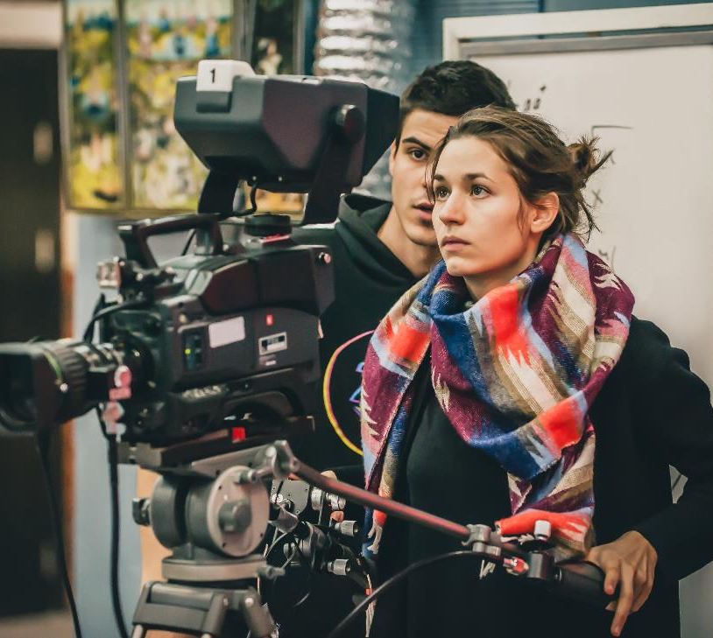
Areas that creative professionals would like more support in
Over a third of creative professionals would like more support in marketing and business management. Business skills are reported earlier as less important for a career in the creative sector, but we see here that they are still seen as necessary part of working in the sector.
Source: E2. In which of the following areas would you like more training, opportunities or resources to support your career in the creative sector?
Base: Total (n=603).

Slide 51
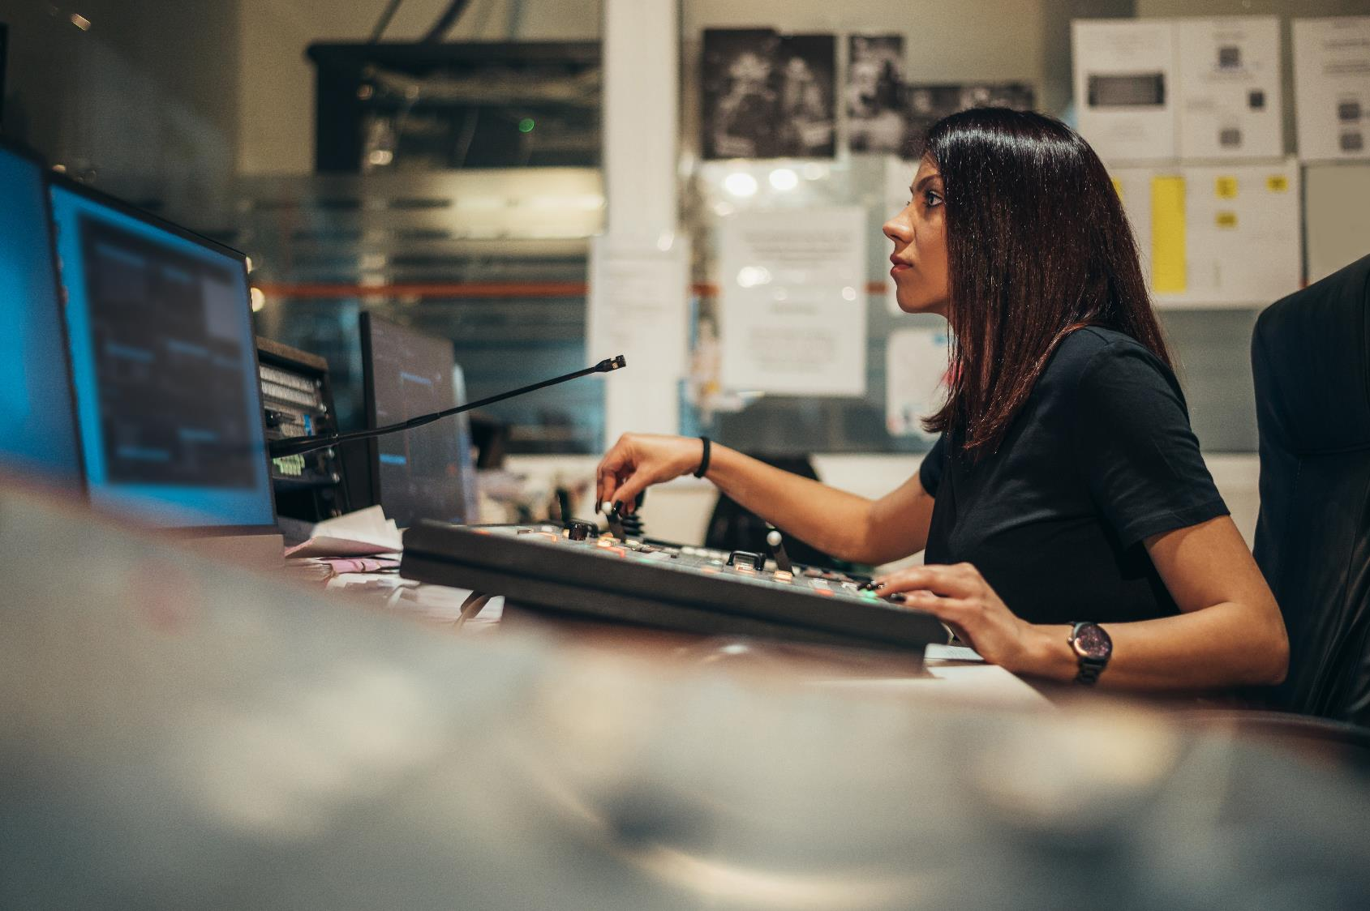
10
Overseas experience

Slide 52
Perceived necessity of going overseas to further career
Just over half (53%) of all creative professionals agree that it is necessary to learn from, or work with, overseas-based creative professionals to sustain a career in the creative sector. Levels of agreement remain relatively consistent across all creative occupations and the surveyed demographics, aside from creative professionals aged 60 plus who are less likely than average to agree that this is necessary (43%).
Pic
Source: D12. How much do you agree or disagree that it is necessary to learn from or work with other creative professionals based outside of New Zealand to sustain your career in the creative sector?
Base: Total (n=603).

Slide 53
Time spent learning from / working worth overseas creatives
Two thirds of creative professionals have spent time collaborating with overseas creatives to sustain their career. This includes both spending time overseas (44%) and online (34%) – with 14% of professionals having done both. Music and sound artists, performing arts creatives, those finding it difficult on present income, and established artists are more likely than average to have done this, while those still becoming established and Māori creative professionals are less likely.
More likely than average (64%) to have spent time with overseas creatives to support career:
Music and sound artists (73%)
Those finding it difficult on present income (72%)
Performing artists(71%)
Established in career (67%).
Less likely than average (64%) to have spent time with overseas creatives to support career:
Those becoming established in their career (57%)
Māori creative professionals (54%).
44%
have spent time overseas to support their creative career
64%
have spent time learning from or working with overseas creatives to support their creative career*
34%
met digitally with overseas creatives to support their creative career
Note: *This is a nett figure, it does not equal the sum of those who spent time overseas to support their creative career, and those who met digitally with overseas creative because 14% of creative professionals did both of these things.
Source: D10. Have you spent time learning from or working with other creative professionals based outside of New Zealand (either in person or digitally) to support your career in the creative sector?
Base: Total (n=603).

Slide 54
Benefits of overseas experience
Almost all creative professionals (98%) who have collaborated with colleagues based outside of New Zealand feel the experience benefited them in some way. The top three benefits are new ideas and inspiration, more experience and new contacts.
Those who travelled overseas are more likely to feel they gained more experience, new contacts, a strengthened reputation, greater sense of value, and better money, in comparison to those who worked with overseas professionals remotely.
= Significantly higher/lower between In person and Digitally data.
Source: D11. In what ways, if at all, did spending time outside of New Zealand benefit your career in the creative sector?
Base: Those who worked with overseas creative professionals to further their creative career (n=387).

Slide 55
11
The gig economy

Slide 56
Gig economy by discipline
Seventy-one percent of creative professionals identify themselves as working within the gig economy. Video game development stands apart from the other arts forms, being the only one where participation in the gig economy is not the norm.
Consider themselves a part of the gig economy
Pacific arts
(n=15)*
Performing arts
(n=178)
Music and sound
(n=173)
Media production
(n=159)
Community arts
(n=83)
93%
83%
82%
80%
78%
71%
Total
(n=603)
Writing / literary arts
(n=111)
Craft / object arts
(n=77)
Ngā toi Māori
(n=63)
Visual arts
(n=135)
Video game development
(n=56)
77%
71%
71%
68%
20%
= Significantly higher/lower than average | *Small base size, interpret with caution
Source: H2 - The gig economy is a way of working that is based on people having temporary jobs or doing separate pieces of work, each paid separately, rather than working for an employer in a permanent role. Would you consider yourself to be part of the gig economy?
Base: Total (n=603).

Slide 57
Weighing up the gig economy
Over a third (39%) of creative professionals participating in the gig economy agree that it has more downsides than benefits, with only 19% indicating otherwise. The gig economy offers a more balanced lifestyle for 39% of these creative professionals, but an equal proportion disagree. Most (60%) creative professionals feel they would earn more if they had a permanent job.
The gig economy has more downsides than benefits
The gig economy allows me to achieve better work-life balance
I earn more in the gig economy than I would if I had a permanent job
Disagree
Agree
Source: H3 - How much would you agree or disagree with the following statements about the gig economy?
Base: Those who consider themselves a part of the gig economy (n=430)

Slide 58
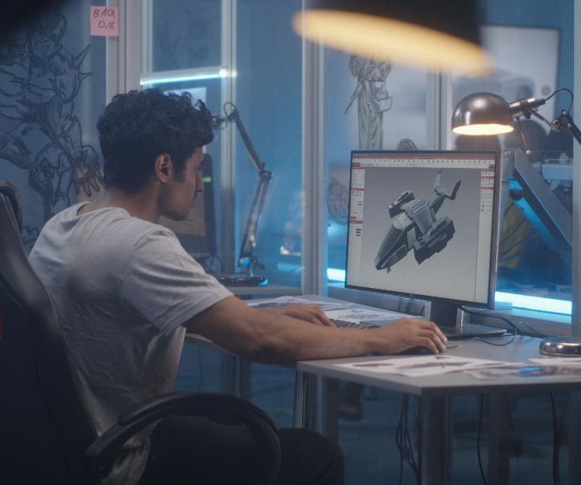
Personal income (after expenses) by work arrangements
Indeed, those who consider themselves to be part of the gig economy are paid less than half that of their waged and salaried counterparts. This difference is driven by video game developers, who are among the highest earners in the sector and mainly do not consider themselves part of the gig economy.
Total income, after expenses
Source: H2 F10B F10C F10D F11 F12 F13
Base: All participants that had provided answers in the income section.

Slide 59
Challenges of the gig economy
The gig economy creates some unique challenges. Almost all (94%) creative professionals participating in the gig economy find it difficult to secure loans for things like mortgages, and four out of five find it difficult to predict how much money they are going to make, and struggle with the lack of holiday and sick pay. Understanding contracts is markedly less challenging, with only three in ten indicating they find this aspect of working in the gig economy difficult.
% very / quite difficult
Source: H4. How easy or difficult do you find the following aspects of the gig economy?
Base: Those who consider themselves a part of the gig economy (n=430)

Slide 60
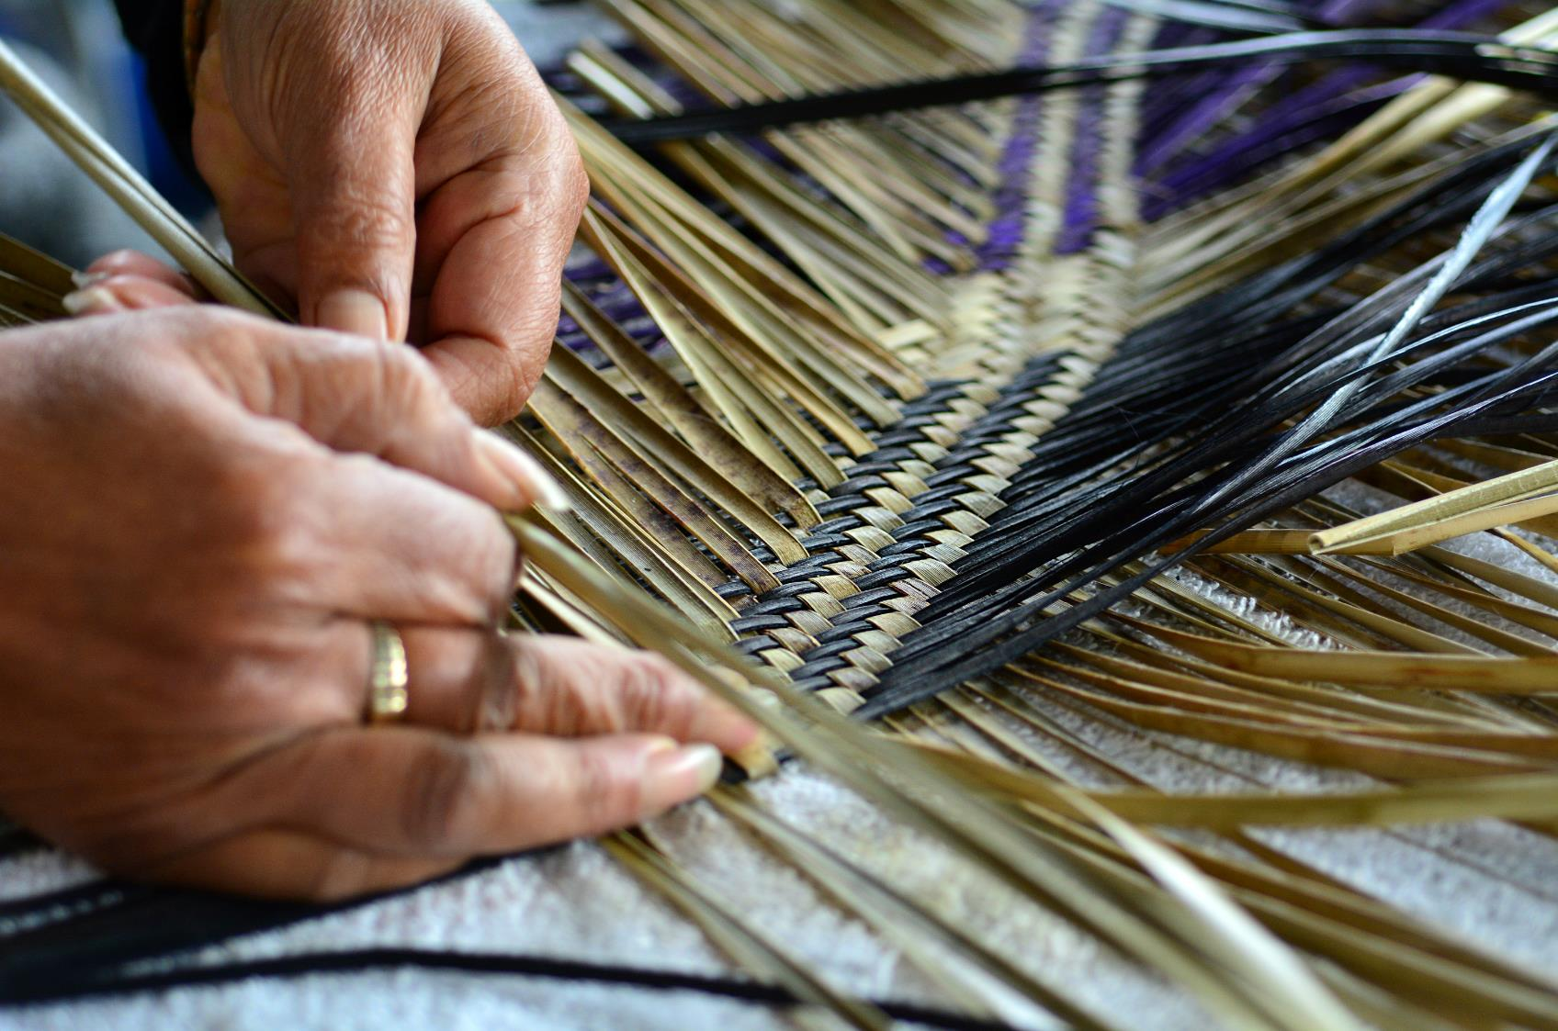
12
Contractual arrangements and understanding of intellectual property

Slide 61
Satisfaction with contracts
Fifty-eight percent of creative professionals have signed a short term employment contract. In addition, 31% have signed a contract for help with promotions. Half of those that have signed a short term employment contract feel satisfied with it, and only 12% were dissatisfied. Creative professionals are less satisfied with contracts they have signed for help with promotions, with an equal proportion satisfied and dissatisfied.
Signed a short-term
employment contract
(less than 12 months)
58%
YES
12%
51%
n=603
n=287
Signed a contract
for help with
promotions
31%
YES
31%
34%
n=603
n=128
Source: E3. Have you ever signed the following types of contract in your creative career? | E4. How satisfied or dissatisfied are you with the most recent [short term employment contract / contract for promoting you or your work] which you have signed for work in the creative sector?
Base: Total (n=603). Satisfaction with short term employment contract (n=287), satisfaction with contract for help with promotion (n=128)

Slide 62
Suggestions for improvements to contracts
The top suggestion for improvements to contracts is higher wages and rates. Creative professionals would also like to see contracts which offer them more protections, are standardised and easy to understand.
“Better pay, that recognised training, rehearsal / development time, and costs (ACC, KiwiSaver etc).”
“Got forced to work unpaid overtime with the threat of losing my job if I didn't. This was not covered in the contract, but I was young and naïve.”
“A database of template contracts that freelancers could use would be useful. Giving them the power rather than the employer.”
“Access to sound advice (from paid professionals).”
Note: Themes mentioned by less than 2% of respondents not included in the chart
Source: E5. From your experience, what could be done to improve the way in which contracts operate for people working in the creative sector?
Base: Those who have signed a contract (n=415)

Slide 63
Knowledge of Contracts, Intellectual Property and Royalties
Almost all creative professionals have at least a basic understanding of contracts, Intellectual Property (IP) and Royalties. Creative professionals tend to have a stronger understanding of contracts than IP and Royalties.
At least a
reasonable
understanding
61%
51%
49%
Source: E7. How would you rate your understanding of the following in terms of how it impacts your creative career?
Base: Total (n=603).

Slide 64
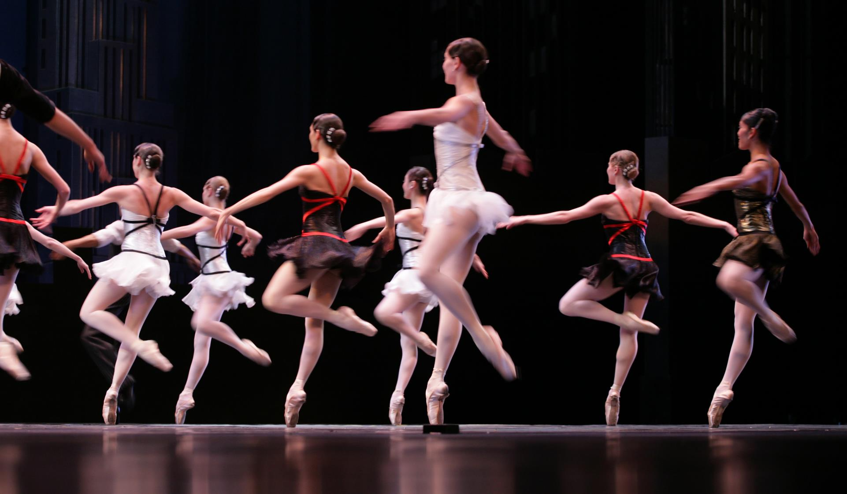
13
Glossary

Slide 65
Job titles included under each of the creative sectors
Craft and object arts: Carver, fibre or textile artist, glass artist, jewellery maker, leather worker, potter or ceramic artist, sculptor, wood worker other type of craft and object artist.
Community arts: Community artist, community arts coordinator, youth arts, other community artist.
Media production: Art director, broadcast DOP, choreographer, costume designer, director, DOP – 3D, DOP –digital, DOP – film, editor, make-up artist, composer, postproduction supervisor, producer, production designer, scenic artist, scriptwriter, sculptor, carver, sound designer, special effects, stills photographer, storyboard artist, te reo advisor, VFX supervisor, voice over artist, other type of media production worker.
Music and sound: Accompanist, arranger, chamber or ensemble player, composer, conductor, instrumental player (soloist), instrumental player in a live band, instrumental player in an orchestra, instrumentalist working in a studio, lead singer in a group, lead singer in musical theatre, music engineer, music producer, opera singer (chorus), opera singer (principal), singer or song writer, solo artist, soloist in classical music, support singer in a group, support or chorus singer in music theatre, other type of music and sound artist.
Ngā toi Māori: Including artists and practitioners working in pūoro (music including taonga pūoro - instruments), kaupapa waka (waka building and sailing), whakairo (carving), raranga (weaving), tā moko (tattooing), kapa haka, uku (pottery, clay), whare tapere (theatre, dance) and all forms of contemporary Māori arts practice craft/object art, dance, interarts, literature, music, theatre and visual arts.
Pacific arts: Pasifika artists, undertaking contemporary and heritage arts projects – including material artist, performing artist, oral artist, and other types of Pacific artist.
Performing arts: Comic artist or comedian, costume designer, director, film actor, lighting designer, mime artist, physical or circus performer, playwright, producer, puppeteer, radio actor, set design, stage / theatre actor, story telling, television actor, theatre devisor, other type of acting - theatre and media, artistic director, choreographer, dancer, principal or feature dancer, other type of dance.
Video game development: 3D artist, animator, art director, game designer, composer, producer, screen writer, software developer, sound designer, storyboard artist, visual artist / illustrator, voice over artist, other type of creative professional involved with video game development.
Visual arts: Animator, book illustrator, cartoonist, installation artist, multi-media artist, painter, performance artist, photographer, print maker, sculptor, video or film artist, other type of visual artist.
Writing / literature: Book illustrator, children or young adult fiction writer, lyric writer / librettist, non-fiction writer, novelist, stage playwright, poet, reviewer or critic, scriptwriter, short story writer, other type of writer or literary artist.

Slide 66
14
Appendix

Slide 67
Sample profile
Sample size
305
280
18
Sample size
469
109
34
38
50
43
Gender
Ethnicity*
Age
89
142
156
127
89
63
Note: data is unweighted | *Participants were able to select multiple ethnicities, therefore percentages sum to more than 100%
The Washington Group Short Set on Functioning (WGSS) was used to identify Deaf and disabled creative professionals in the survey
Source: A1. First of all, how old are you? | A2. Which ethnic group do you belong to? | G1. Which gender do you most identify with?
| G6a. Do you have difficulty with any of the following?
Base: Total (n=603).

Slide 68
For further information please contact:
Katelynn Fuller or Gabrielle Po Ching
katelynn.fuller@kantarpublic.com
gabrielle.poching@kantarpublic.com
Kantar Public
Level 9, 101 Lambton Quay
Wellington 6011
Phone (04) 913 3000

